Slide 1

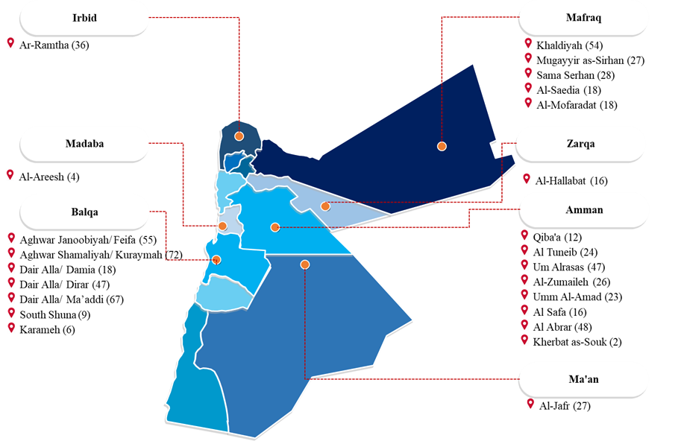
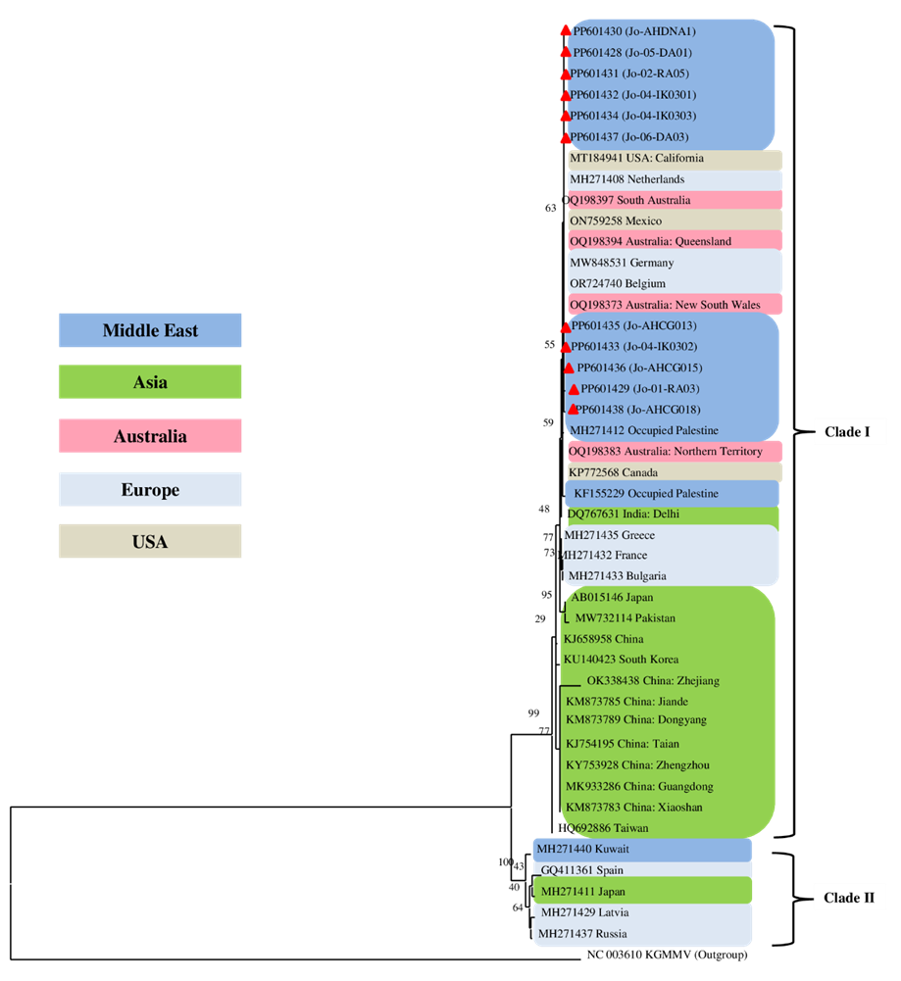
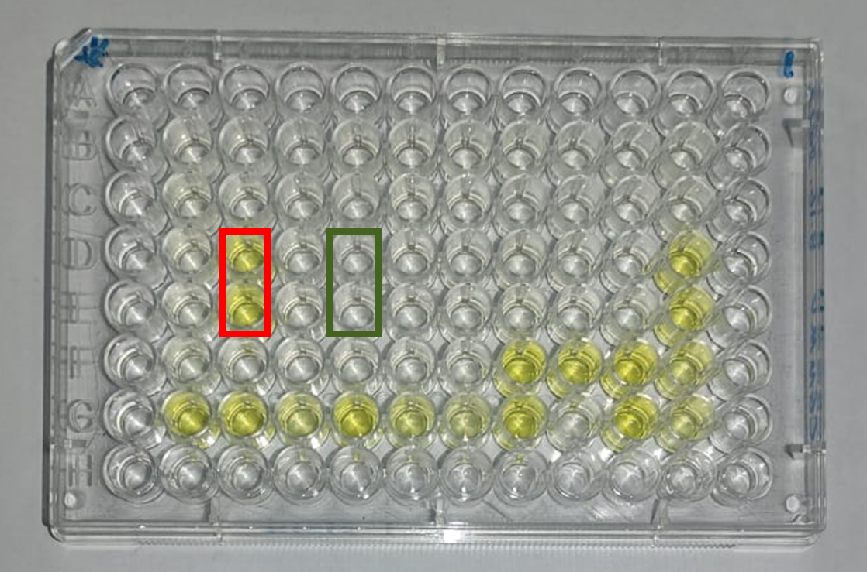
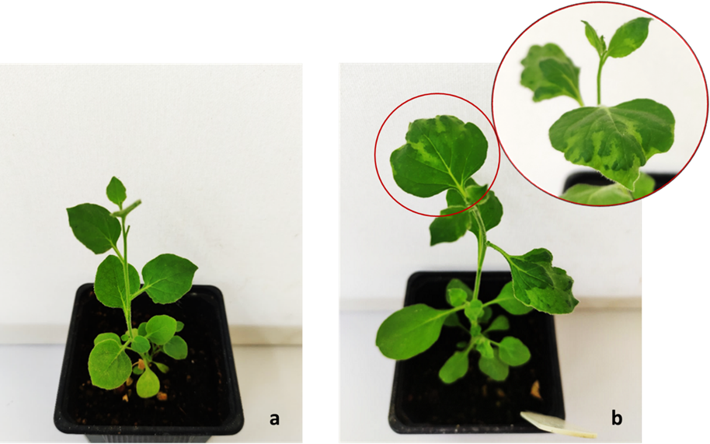
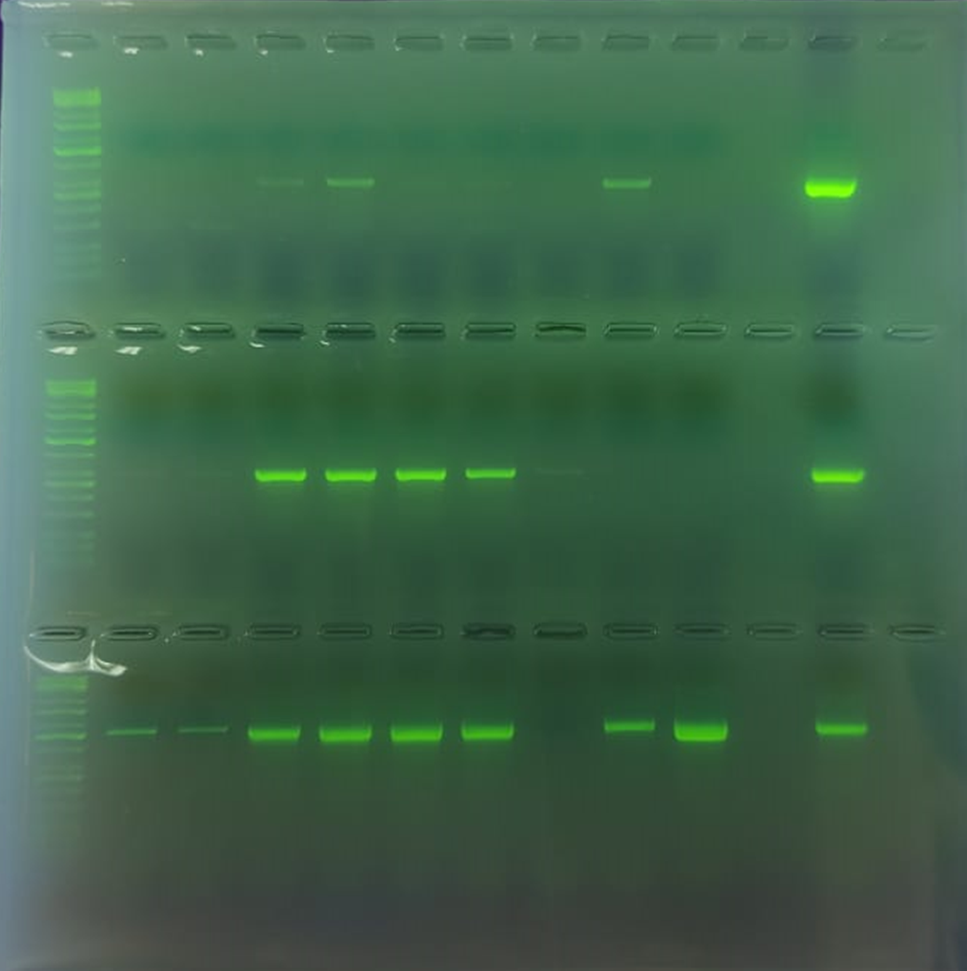
Occurrence and partial genetic characterization of cucumber green mottle mosaic virus (CGMMV) infecting cucurbits in Jordan
Areej Akram Hussein (Supervisor: Dr. Nida' Salem)
Department of Plant Proctection, School of Agriculture, The University of Jordan, Amman 11942, Jordan.
Introduction– ‘Cucumber green mottle mosaic virus’
Cucumber green mottle mosaic virus (CGMMV): is an important virus species, a member of Tobamovirus genus, that causes damaging disease in cucurbits reducing yield quality and quantity worldwide. Viruses belonging to tobamoviruses are known to be highly infectious and they can result in severe symptoms and economic losses.
Transmission: Due to the stability of CGMMV, it has the ability to be transmitted mechanically, by seeds, water and soil. However, no specific vector has been reported to transmit CGMMV so far.
Importance: CGMMV is considered a major threat to cucurbit production globally since it is a seed-borne virus and it expands worldwide in a large-scale via the international seed trade. Cucurbits and other wild plants can act as alternative hosts.
Materials & Methods
Results
Field sample collection: Leaves of different cucurbit and weed plants were collected from the major cucurbit growing areas (Amman, Al-Jafr, Al-Mafraq, Al-Zarqa, Ar-Ramtha, Jordan Valley and Madaba) in Jordan during 2022-2023. 40 seed lots of different cucurbit seed varieties were obtained/purchased from local markets.
Double Antibody Sandwich-Enzyme Linked Immunosorbent Assay (DAS-ELISA): DAS-ELISA was performed using a CGMMV commercial kit (Agdia) as described by Clark and Adams (1977).
Total RNA and DNA extraction and virus PCR detection: Total RNA and DNA were isolated RNeasy Plant Mini Kit and DNeasy Plant Mini Kit (QIAGEN) from leaves. PCR with specific primers for CABYV, CCYV, CGMMV, CLSV, CVYV, CYSDV, SqVYV, WMV, SqLCV, WmCSV and ToLCNDV.
Mechanical Inoculation: Five representative CGMMV-ELISA-positive samples were biologically assayed on indicator plants: C. amaranticolor, C. murale, C. quinoa, D. metel, D. stramonium, G. globosa, N. benthamiana, N. glutinosa and N. tabacum.
Cloning and sequencing: pGEM-T easy vector was used for DNA cloning followed by Bidirectional Sanger Sequencing (Macrogen, Korea).
Sequence analysis: BLAST, phylogenetic tree (MEGAX) (Kumar et al., 2018).
Field survey: CGMMV was not detected by ELISA in these cucurbits (squash, melon, watermelon, bottlegourd, pumpkin and snake melon) or weed samples. PCR results revealed that 81/95 cucurbit samples were positive, 32.1% (26/81) of the PCR-positive tested samples were singly infected with viruses (CYSDV, CCYV, CLSV, SqLCV or WmCSV) and 67.9% (55/81) of the PCR-positive tested samples had a mixed infection. BLAST analysis: The partial nucleotide sequence of CP gene of CGMMV Jordanian isolates showed similarities to other isolates available in the NCBI database ranging between 88.3-100%.
Virus transmission: Cucumber plants inoculated with CGMMV-ELISA-Positive isolated collected samples developed CGMMV representative symptoms: mosaic, mottling and malformation.
Phylogenetic analysis: Two main clades were formed. All CGMMV-Jordanian isolates (arrowed with ▲ red triangle) were clustered in Clade I. All 11 isolates reported in this study shared nucleotide sequence similarity ranging 97.2% to 100% when compared with other isolates in Clade I. And showed high diversity when compared with isolates of Clade II ranging from 88.3% to 90%.
Virus Detection and Identification
DAS-ELISA: Absorbance was taken at 405 nm extinction value (A₄₀₅).
Mechanical inoculation: From CGMMV-ELISA- positive samples.
Molecular detection: from representative samples.
Positive control
Negative control
Evolutionary relationships of Jordanian CGMMV isolates (Arrowed with red triangle ▲) with previously reported GenBank sequences by using ML method with 1000 bootstrap replicates. Kyuri green mottle mosaic virus (KGMMV) was used as outgroup. Evolutionary analysis was conducted in MEGA X
Conclusions
The development of a yellow color indicated that the tested sample was CGMMV-positive. CGMMV was prevalent only in cucumber samples in a total of 63 out of 700 collected samples from 6 out of 48 different cucurbit fields, and restricted in 3 different geographical regions, including: Amman (Al Abrar and Al Safa), Ar-Ramtha and Jordan Valley (Dair Alla/Dirar and Ma’addi).
Six cucumber seed lots and one melon from 5 different companies out of 40 tested seed lots were found to be CGMMV-positive.
Mechanically inoculated N. benthamiana; a: healthy plants (control) and b: inoculated plant showing systemic mosaic symptoms 16 days post inoculation (dpi). Only N. benthamiana exhibited mosaic symptoms and leaf malformation, while other indicator plants did not show any type of symptoms. Infection with CGMMV was confirmed by DAS-ELISA. Positive results were obtained only from C. amaranticolor, C. murale, C. quinoa, D. stramonium, G. globosa and N. benthamiana.
Agarose gel analysis (1.5%) resulting from PCR detection of the tested virus in the samples of cucurbit plants. NC is a negative healthy cucumber plant control. CGMMV, CABYV, CCYV, CLSV, CVYV, CYSDV, SqVYV, SqLCV and WmCSV were detected in different cucurbit species. WMV and ToLCNDV were not detected. CYSDV and SqLCV were the predominant viruses affecting cucumber. While on squash, SqLCV was the most dominant virus, followed by CYSDV. In the case of melon and watermelon, WmCSV emerges as the dominant virus.
CGMMV was found among cucurbits only in cucumber plants and has restricted distribution.
CGMMV was not detected in wild plants grown in cucurbit fields.
CGMMV was detected in commercial cucurbit seed lots present in Jordan markets and this indicated the necessity of imposing seed testing and quarantine regulations.
Other viruses were detected in this study and need further investigations. Occurrence of SqVYV on cucurbits in Jordan was reported for the first time and can be further studied.
References:
Clark and Adams, 1997. Journal of General Virology, 34: 475-483.
Kumar et al., 2018. Molecular Biology and Evolution, 35: 1547-1549.
Acknowledgements: Funding was received from the Deanship of the Scientific Research, the University of Jordan.

