Slide 1
SESSION 6: Financial Aspects and Budgeting
Eligible costs, Ineligible costs
PRIMA Budget template and lines
Third Parties
Archiving: keeping records, supporting documentation
Reporting and payment requests
Checks, reviews, audits and investigations
The PRIMA programme is an Art.185 initiative supported and funded under Horizon 2020, the European Union’s Framework Programme for Research and Innovation.

Slide 2
1. Eligible Costs, Ineligible Costs

Slide 3
This training material has been prepared via PRIMA-IS for training purpose only.
Eligible Costs – how to Calc. your budget?
COST
ACTUAL
UNIT
FLAT RATE
LUMP SUM
trategic Research and Innovation Agenda
raft - August 10th 2017
This applies to Section 1 as for section 2 national rules apply.
Notes:
- Introducció H2020 . Donar per fet el que saben els assistents

Slide 4
This training material has been prepared via PRIMA-IS for training purpose only.
Eligible Costs
A) ACTUAL COSTS (Art 6.1 MGA)
1- Must be actually induced by the beneficiary
2- During the period of the action/project
3- Must be indicated in the estimated Budget (excel File)
4- Must be run in connection with the action as described in Annex 1
5- Must be identifiable and verifiable
6- Must comply with the applicable national law of taxes, labour and social security
7- Must be reasonable, justified and must comply with the principle of sound financial management.
trategic Research and Innovation Agenda
raft - August 10th 2017

Slide 5
This training material has been prepared via PRIMA-IS for training purpose only.
Eligible Costs
SPECIFIC CASES ACTUAL COSTS
1- Cost related to project activities (staff cost, events, printing…) ELIGBLE
1- Depreciation costs for equipment used for the action, but bought before the action starts. ELIGIBLE
2- Cost related to preparing, submitting and negotiating the proposals. NOT ELIGIBLE
3- Costs related to drafting the consortium agreement. NOT ELIGIBLE
4- Travel Costs for the kick-off meeting. ELIGIBLE
5- Costs of reporting at end of the action. ELIGIBLE
6- Cost to allow for the participation of disabled people. ELIGIBLE
trategic Research and Innovation Agenda
raft - August 10th 2017
Notes:
Papers done after the Grant agreement Will be no accepted as eligible costs.

Slide 6
This training material has been prepared via PRIMA-IS for training purpose only.
Eligible Costs
B) UNIT COSTS
- Usual accounting practices
- Must be calculated as follows: Number of actual units x Amounts per unit
C)LUMP SUM
Payment exclusively based on outcome base payment
Example: A measurement campaign, clinical tests.
D) FLAT RATE COSTS
Calculated by applying the flat rate to eligible costs (Example: 25% Eligible direct costs will be indirect costs)
trategic Research and Innovation Agenda
raft - August 10th 2017
Notes:
UNIT COSTS
- Certificate?? It is obligatory
Number of units must be necessary for the action
Units must be used or produced during the acion duration

Slide 7
This training material has been prepared via PRIMA-IS for training purpose only.
Ineligible costs
Costs that do not comply with the conditions set out in the eligible costs:
Doubtful debts
Currency Exchange losses
Excessive or reckless expenditure
Deductible VAT

Slide 8
2. PRIMA Budget Template and Lines

Slide 9
This training material has been prepared via PRIMA-IS for training purpose only.
PRIMA Budget template and sections
Salaires personnels permanents
Missions
Equipement
Autres biens et services
Couts de facturation interne
Sous traitance
Overheads

Slide 10
This training material has been prepared via PRIMA-IS for training purpose only.
PRIMA Budget template and sections
IMPORTANT:
Cost per PM!
IA-RIA
Profit-Non Profit
Depreciation Costs
Goods and services: Best value for money

Slide 11
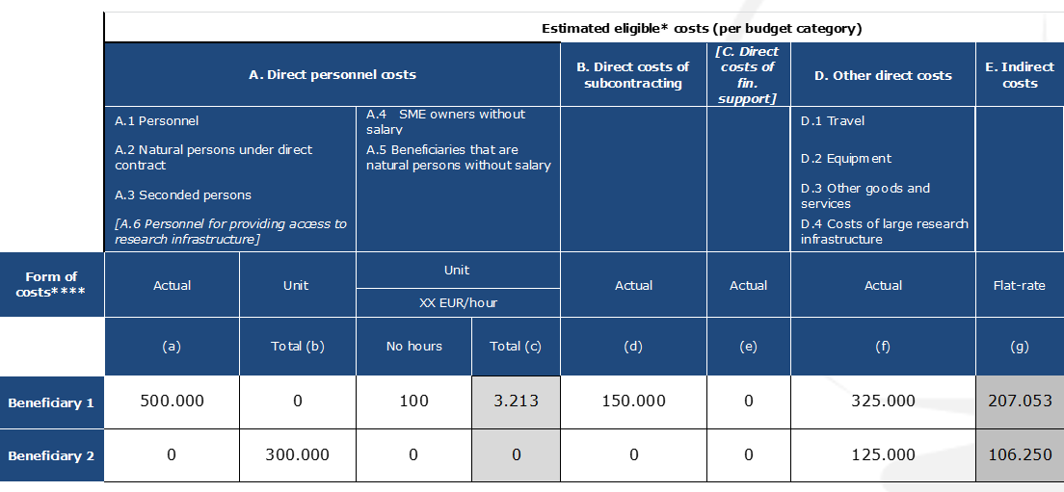
Budget Category Transfers :
This training material has been prepared via PRIMA-IS for training purpose only.

Slide 12
This training material has been prepared via PRIMA-IS for training purpose only.
Budget Lines
A)Direct Personnel Costs
B) Direct costs of subcontracting
C) Direct costs of providing financial support to third parties
D) Other direct costs
E) Indirect costs
DIRECT COSTS: Costs directly linked to the action implementation and can be attributed directly to it.
INDIRECT COSTS: Costs NOT directly linked to the action implementation and cannot be attributed directly to it.
trategic Research and Innovation Agenda
raft - August 10th 2017
Notes:
7% coordinació del total PRESSUPOST pel coordinador

Slide 13
This training material has been prepared via PRIMA-IS for training purpose only.
Eligible Costs
A) DIRECT PERSONNEL COSTS (Art 6.2 MGA)
- Costs for employees
Personnel costs for employees (salary +social security contributions)
GENERAL RULE: HOURS WORKED (time records) x HOURLY RATE+ (Additional Remuneration )
- Hourly rate can be calculated either annually or monthly
- Productive hours
a) 1.720 hours
b) Individual productive hours
trategic Research and Innovation Agenda
raft - August 10th 2017
Notes:
-1720 h: si el contrato no especifica el número de horas máximas (labor agreeement)
- Individual Productive hours: number of hours real worked by a person (horas laborables + horas extras)

Slide 14
This training material has been prepared via PRIMA-IS for training purpose only.
Eligible Costs
A) DIRECT PERSONNEL COSTS (Art 6.2 MGA)
REMINDERS!
1- Staff working on the project must keep time records (MGA Article 18)
- Staff must record the hours they spend on the project
- regularly (daily, weekly)
- countersigned by a supervisor
2- Regular errors:
- Staff working on the project and sick or on holiday at the same time!!
- Hours claimed cannot be supported
- Impossible number of hours claimed
trategic Research and Innovation Agenda
raft - August 10th 2017
Notes:
-1720 h: si el contrato no especifica el número de horas máximas (labor agreeement)
- Individual Productive hours: number of hours real worked by a person (horas laborables + horas extras)

Slide 15
This training material has been prepared via PRIMA-IS for training purpose only.
Eligible Costs
Specific cases direct personnel costs
Teleworking. ELIGIBLE
Benefits in kind. ELIGIBLE (e.g costs of lunch vouchers)
Recruitment costs. NON ELIGIBLE
Students, PhDs under scholarship, internhip or similar agreement. ELIGIBLE
Parental live. ELIGIBLE
- Costs for natural persons working under a direct contract
Costs of in-house consultants similars (i.e self-employed)
- Costs for personnel seconded by a third party
B) DIRECT COSTS OF SUBCONTRACTING
Covers the price paid for subcontracts and related taxes.
Must be declared as actual costs
Be incurred for the subcontracting of action tasks described in Annex 1.
trategic Research and Innovation Agenda
raft - August 10th 2017

Slide 16
This training material has been prepared via PRIMA-IS for training purpose only.
Eligible Costs
C) OTHER DIRECT COSTS
- Travel costs
- Covers the travel costs and related subsistence allowances spent for the action
- Be in line with the beneficiary’s usual practices on travel.
Specific cases
Combination with personal travels or travels for other purposes.
- Equipment
a) Depreciation costs of equipment, infrastructure or other assets
b) Costs of renting or leasing equipment
trategic Research and Innovation Agenda
raft - August 10th 2017
Notes:
- The depreciable amount of the equipment must be allocated on a systematic basis over its useful life.
- If the beneficiary does not use the equipment exclusively for the action, only the portion used on the action may be charged
- The beneficiary can NOT charge depreciation for periods before the purchase of the equipment.
Specific cases Depreciation
- Equipment bought before the action start. Only the depreciation costs remaining.
- Cash-based accounting
- Full Price of an asset in one single year.

Slide 17
This training material has been prepared via PRIMA-IS for training purpose only.
Eligible Costs
C) OTHER DIRECT COSTS
- Other goods (Art 10 MGA)
Goods and services purchased for the action. It is not necessary to detail in Annex 1
- Consumables and supplies
- Intellectual property rights
- Certificates on financial statements
- Costs of internally invoiced goods and services
Costs for goods and services which the beneficiary itself produced or provided for the action.
trategic Research and Innovation Agenda
raft - August 10th 2017
Notes:
- Specialised premises for hosting the research specimens used for the action (e.g greenhouse)
- Use of specific research devices or research facilities (e.g electronic microscope)
- Self produced consumables (e.g chemicals

Slide 18
This training material has been prepared via PRIMA-IS for training purpose only.
Eligible Costs
D) INDIRECT COSTS
Indirect costs are eligible if they are declared on the basis of the flat-rate of 25% of the eligible DIRECT costs from which are EXCLUDED:
- Costs of subcontracting
EXAMPLE:
A public university is a beneficiary under a GA and has incurred the following costs:
-100.000 € personnel costs
- 20.000 € subcontracting costs
- 10.000 € Other direct costs
Eligible DIRECT costs: 100.000 + 20.000 + 10.000 = 130.000 €
Eligible INDIRECT costs: (100.000+10.000) x 25%= 27.500 €
Total Eligible costs: 157.500 €
trategic Research and Innovation Agenda
raft - August 10th 2017

Slide 19
3. Third Parties

Slide 20
This training material has been prepared via PRIMA-IS for training purpose only.
Third Parties
⇨ What is a third party?
A legal entity which carries out work of the action, supplies goods or provides services for the action, but which did not sign the grant agreement
⇨ What types of third parties?
1. Third parties directly carrying out part of the work described in Annex 1
2. Other third parties: providing resources, goods or services to the beneficiaries for them to carry out the work described in Annex 1
Source: European Commission, EC
trategic Research and Innovation Agenda
raft - August 10th 2017

Slide 21
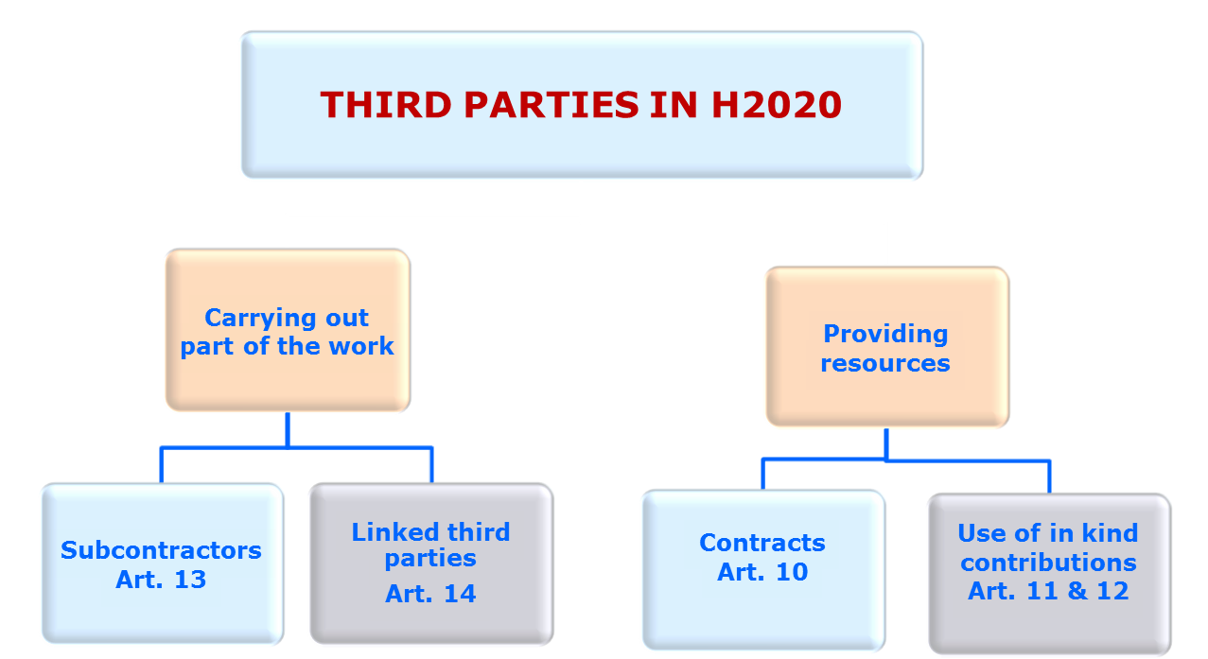
This training material has been prepared via PRIMA-IS for training purpose only.
Third Parties
Source: European Commission, EC
trategic Research and Innovation Agenda
raft - August 10th 2017

Slide 22
4. Archiving: keeping records, supporting documentation

Slide 23
This training material has been prepared via PRIMA-IS for training purpose only.
Keeping records-Supporting documentation
- Five years keep records and other supporting documentation.
- Original documents.
-The beneficiaries must keep the records and documentation supporting the costs declared:
a) Actual costs: e.g: contracts, subcontracts, invoices and accounting records.
b) Unit costs: Adequate records and other supporting documentation to prove the number of units declared.
-‘Certificate on the methodology’ Stating that their usual cost accounting practices comply with these conditions.
-In addition, for personnel costs (only for persons who don’t work exclusively on the action), the beneficiaries must keep time records (writing and approved by the persons working on the action) for the number of hours declared (at least monthly).
trategic Research and Innovation Agenda
raft - August 10th 2017

Slide 24
5. Reporting and payment requests

Slide 25
This training material has been prepared via PRIMA-IS for training purpose only.
Report and Payment Requests
- The coordinator must submit a periodic report within 60 days following the end of each reporting period.
-Periodic financial report:
Payment accordance of the work package accomplishment
An individual financial statement
A periodic summary financial statement
-Final financial report:
It is also necessary to include a certificate on the financial statements if the beneficiary requests a total contribution of 325.000 € or more.
-Financial Statements must be drafted in euro. (For non-euro members, Official Journal of the European Union)
trategic Research and Innovation Agenda
raft - August 10th 2017
Notes:
Match between scientific and financial.
We Will pay according the progress of the working package.

Slide 26
This training material has been prepared via PRIMA-IS for training purpose only.
Report and Payment Requests
-Prima Foundation will do the following payments:
1- Pre-financing payment: 60% (max 30 days)
2- Interim payment/s: 30% (max 90 days)
The amount due as interim payment is calculated by the PRIMA Foundation in the following steps:
Step 1: Application of the reimbursement rates
Step 2: Limit to 90% of the maximum grant amount.
3- Payment of the balance: 10% (max 90 days)
- Payments will be made to the coordinator.
trategic Research and Innovation Agenda
raft - August 10th 2017

Slide 27
6. Checks, Reviews, Audits and Investigations

Slide 28
This training material has been prepared via PRIMA-IS for training purpose only.
Checks, reviews, audits and investigations
-The Prima Foundation or the Commission will check the proper implementation of the action and compliance with the obligations under the Agreement. 30% of Beneficiaries
- Reviews may be started up to 2 years after the payment if the balance. These reviews can be carried out directly ( own staff) or indirectly (using external persons or bodies).
- The Prima Foundation or the Commission may carry out audits on the proper implementation of the action.
- European Anti-Fraud office (OLAF) and European Court of Auditors (ECA) can carry out at any moment during the implementation of the action investigations or audits.

Slide 29
END OF SESSION SIX THANK YOU FOR YOUR ATTENTION
Dr. Mohamed Wageih
Project Officer
PRIMA – The Partnership for Research and Innovation in the Mediterranean Area
mohamed.wageih@prima_med.org
PrimaProgram
@PRIMAProgram
Prima Program
Prima-med YouTube

