Slide 1
SESSION 6: Plan Effectively for a Competitive Research Proposal
Logical Framework Matrix - Theory of Changes
Gantt Chart - Pert Diagram (WPs and Tasks)- Useful Tables/Charts
Business Model Canvas – Business Plan
For demonstration purpose only. Not part of the PRIMA official template
The PRIMA programme is an Art.185 initiative supported and funded under Horizon 2020, the European Union’s Framework Programme for Research and Innovation.

Slide 2
This training material has been prepared via PRIMA-IS for training purpose only.
1. Logical Framework Matrix - Theory of Changes
trategic Research and Innovation Agenda
raft - August 10th 2017
For demonstration purpose only. Not part of the PRIMA official template

Slide 3
This training material has been prepared via PRIMA-IS for training purpose only.
Problem Analysis
Current negative situation
Problem Tree
Cause-effect analysis
So what?
Effects
Core problem
But why?
Causes
For demonstration purpose only. Not part of the PRIMA official template

Slide 4
This training material has been prepared via PRIMA-IS for training purpose only.
Problem Analysis
Current negative situation
Positive desirable situation
MY PROJECT
Possible impact and indicators
Effects
Core problem
Key Objective
Possible outputs and activities
Causes
For demonstration purpose only. Not part of the PRIMA official template

Slide 5
This training material has been prepared via PRIMA-IS for training purpose only.
Logical Framework Matrix
Stage 2, Full Application (Excellence OR Impact)
Result chain |  | Indicators | Baseline | Target | Means of Verification | Assumptions
Impact
Outcomes
Output 1
Activities 1.1…
Output 2
Activities 2.1…
trategic Research and Innovation Agenda
raft - August 10th 2017
For demonstration purpose only. Not part of the PRIMA official template

Slide 6
This training material has been prepared via PRIMA-IS for training purpose only.
Logical Framework Matrix
Result chain |  |  | Indicators | Baseline | Target | Means of Verification | Assumptions
Impact/ General Objective/ Purpose |  | The long-term development improvement/positive change to which a project/program is intended to contribute.
Outcome / Specific Objective OC1 or SO1 |  | A change in behavior, to which research outputs and related activities have contributed. |  |  |  |  | Necessary conditions for the outcome to lead to the impact
Output or Deliverables OP1 or D1 |  | Knowledge, technical or institutional advancement produced by the project’s research, engagement and/or capacity development activities. |  |  |  |  | Necessary conditions for the output(s) to lead to the achievement of the outcome
Activities A1.1… |  |  |  |  |  |  | Necessary conditions for the activities to lead to the achievement of the related output
Output OP2
Activities 2.1…
trategic Research and Innovation Agenda
raft - August 10th 2017
For demonstration purpose only. Not part of the PRIMA official template

Slide 7
This training material has been prepared via PRIMA-IS for training purpose only.
Logical Framework Matrix
Result chain |  | Indicators | Baseline | Target | Means of Verification | Assumptions
Impact |  | Quantitative or qualitative metrics that can verify changes relative to what was planned | The situation relative to the indicator prior to project implementation against which progress can be assessed | Level of performance relative to the indicator that the project is projected to accomplish in a given time period | The data sources or reporting mechanisms that specify how the indicator data will be collected
Outcome
Output 1
Activities 1.1…
Output 2
Activities 2.1…
trategic Research and Innovation Agenda
raft - August 10th 2017
For demonstration purpose only. Not part of the PRIMA official template
7

Slide 8
This training material has been prepared via PRIMA-IS for training purpose only.
The Theory of Change of Your Project
Stage 2, Full Application (Impact)
SDGs
PRIMA Topic/ SRIA
National Priorities
Sphere of interest
The greater why?
Impact
Assumptions
Risks
Outcome(s)
Sphere of Influence
Why?
Assumptions
Output 1
Output 2
Output 3
What?
Sphere of control
Assumptions
Assumptions
Work package
Work package
Work package
How?
Inputs $
For demonstration purpose only. Not part of the PRIMA official template
Problem analysis / rationale

Slide 9
This training material has been prepared via PRIMA-IS for training purpose only.
2. Gantt Chart – PERT Diagram
trategic Research and Innovation Agenda
raft - August 10th 2017
For demonstration purpose only. Not part of the PRIMA official template
9

Slide 10
This training material has been prepared via PRIMA-IS for training purpose only.
Gantt Chart – example
Stage 1- Pre Proposal (Excellence)
Stage 2 – Full Proposal (Implementation)
2020
2021
2022
Work Package Name
06
07
08
09
10
11
12
01
02
03
04
05
06
07
08
09
10
11
12
01
02
03
04
05
WP1: Co-ordination and Project Management
WP2: Dissemination and Exploitation
WP3: Assessment and Evaluation
WP1.1:
WP1.2:
WP2.1:
WP2.2:
WP2.3:
WP2.4:
WP3:
WP4:
Milestones
Deliverables
D01
M1
M2
D121
D122
D123
M3
M4
M5
D211
D221
D231
D241
M6
D311
D321
D331
M7
D411
D421
D431
D441
For demonstration purpose only. Not part of the PRIMA official template
10

Slide 11
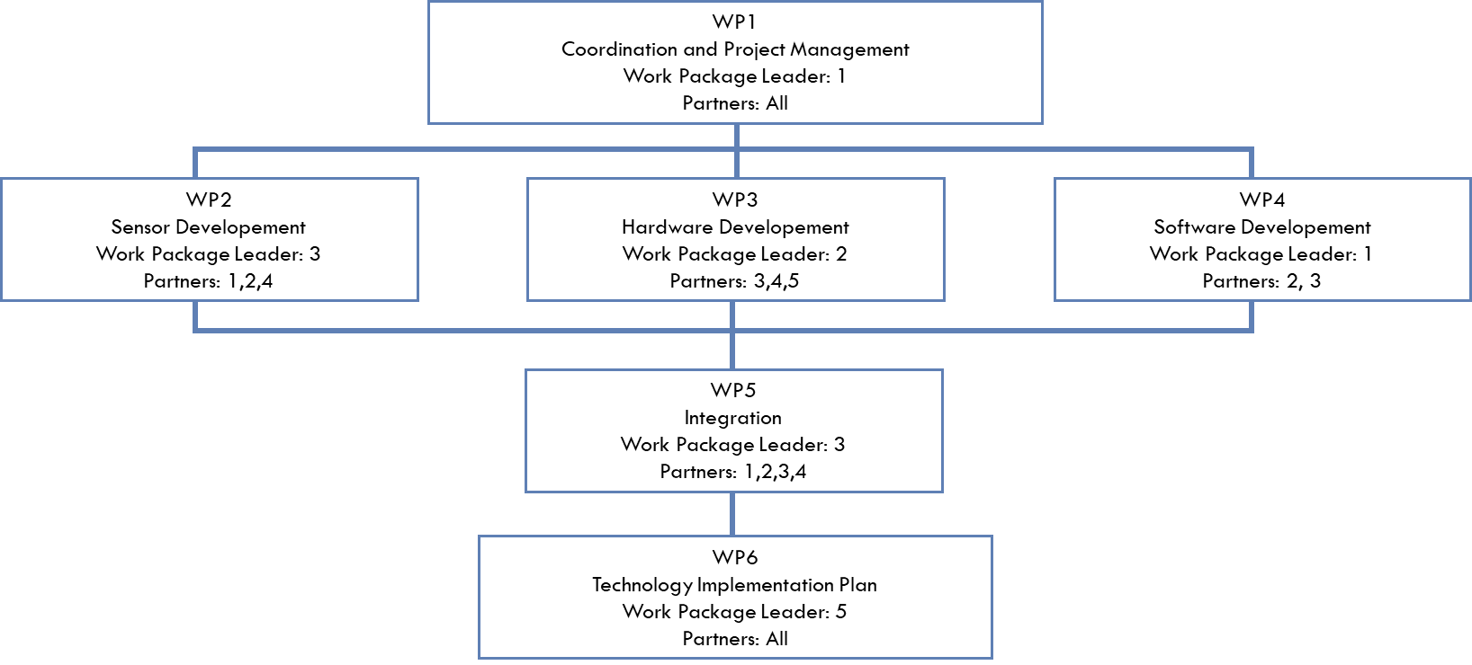
This training material has been prepared via PRIMA-IS for training purpose only.
Work Packages - Task Allocation (PERT Diagram)
Stage 1- Pre Proposal (Excellence)
Stage 2 – Full Proposal (Implementation)
For demonstration purpose only. Not part of the PRIMA official template
11

Slide 12
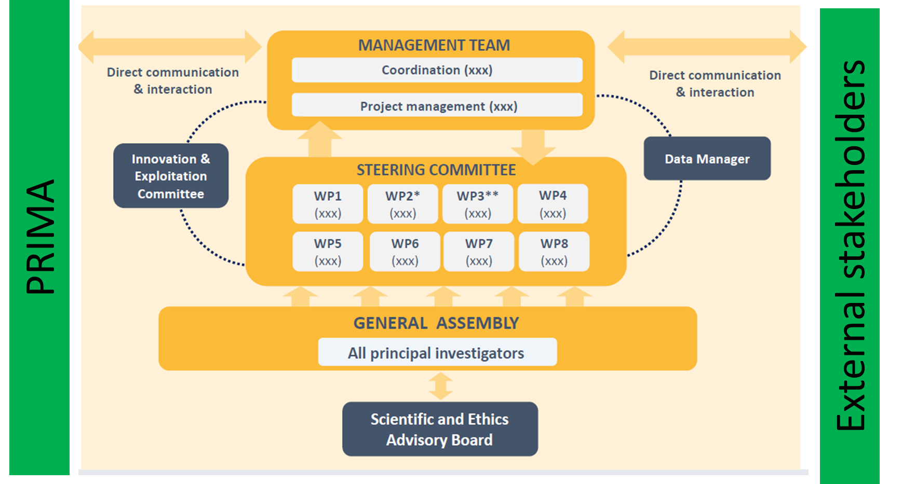
This training material has been prepared via PRIMA-IS for training purpose only.
Work Packages - Task Allocation (PERT Diagram)
For demonstration purpose only. Not part of the PRIMA official template
12

Slide 13
This training material has been prepared via PRIMA-IS for training purpose only.
Work Packages - Task Allocation (Table)
Stage 1- Pre Proposal (Excellence)
Stage 2 – Full Proposal (Implementation)
WPs/ Leader | TASKS | Timeline | Resp. Partner/ Involved Partners | Main Deliverables
WP1: XX1 (WPL: P1) | Task 1.1 - | M1-M8 |  | D1.1, D1.2
 | T1.2 - | M1-M7
 | T1.3 – | M8-M26
WP2: XX2 (WPL: P4) | T2.1 - | M4-M5 |  | D2.1, D2.2, D2.3
 | T2.2 - | M4-M9
 | T2.3 - | M4-M9
WP3: XX3 (WPL: P2) | T3.1 - | M10-M11 |  | D3.1, D3.2, D3.3
 | T3.2 - | M12-M18
For demonstration purpose only. Not part of the PRIMA official template
13

Slide 14
This training material has been prepared via PRIMA-IS for training purpose only.
Some Useful Tables
Stage 1- Pre Proposal (Excellence)
Stage 2 – Full Proposal (Implementation)
PRIMA Topic Challenges & Scope | Project Response
Call Challenge
PRIMA SRIA Objective
Topic Scope
Technology | Initial TRL | Developed Solution | Final TRL
Technology 1 | 3 | New Tech.1 | 6
Technology 2 | 3 | New Tech.2 | 7
Technology 3 | 4 | New Tech.3 | 6
TG/FB | Demands & Challenges | Project Response
[Target Group 1]
[Final Beneficiary 1]
[Target Group 3]
Communication Action | KPIs | Target Audiences
Website | 1 | Public
Leaflets | 1000 | Scientific communities in…
Workshops | 4 | Smallholders in….
WP Title | Start Date | End Date | Resp. Partner | Deliverables
WP1… | M1 | M5 | P1 | D1.1….
WP2… | M3 | M10 | P2 | D2.2….
WPn…. | M23 | M36 | P1 | Dn.1…..
For demonstration purpose only. Not part of the PRIMA official template
14

Slide 15
This training material has been prepared via PRIMA-IS for training purpose only.
Some Useful Charts
For demonstration purpose only. Not part of the PRIMA official template

Slide 16
This training material has been prepared via PRIMA-IS for training purpose only.
3. Business Model Canvas – Business Plan
trategic Research and Innovation Agenda
raft - August 10th 2017
For demonstration purpose only. Not part of the PRIMA official template
16

Slide 17
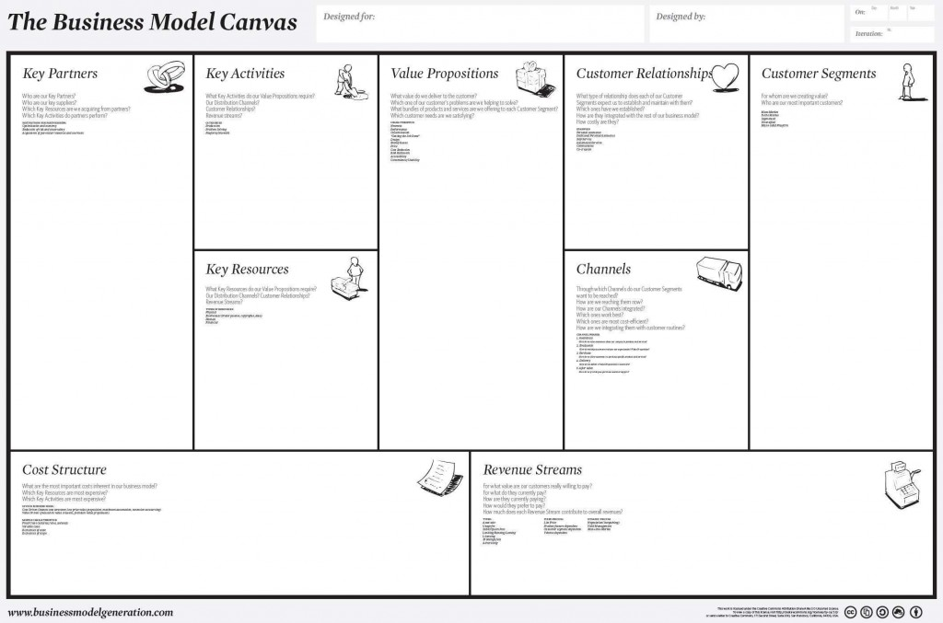
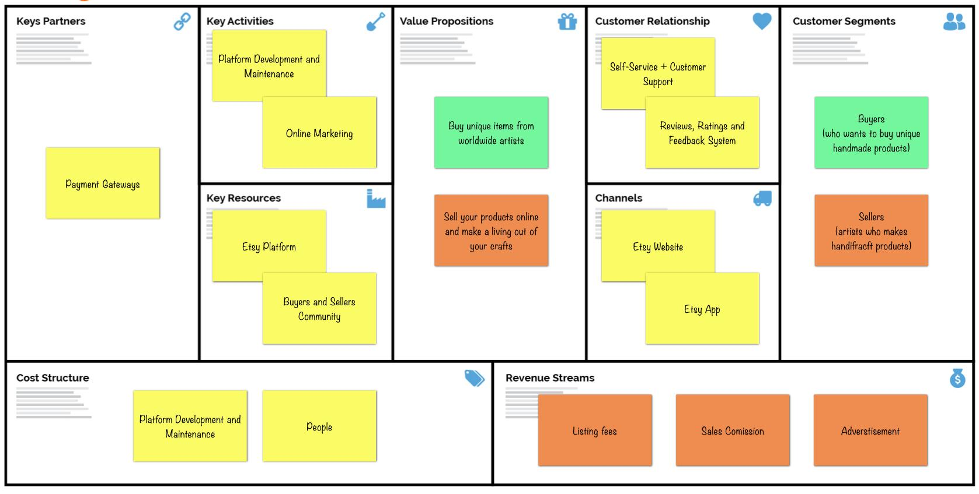
Business Model Canvas
This training material has been prepared via PRIMA-IS for training purpose only.
Stage 1/2 – Full Proposal (Excellence OR Impact)
4
5
1
3
2
8
9
7
6

Slide 18
Business Plan – in BRIEF
This training material has been prepared via PRIMA-IS for training purpose only.
Stage 1/2 – Full Proposal (Excellence OR Impact)
Summary.
Product Description.
Market Analysis.
Competitive Analysis/ available Alternatives and USPs.
Tentative Marketing and Sales Plan.
Budgeting and Use of Resources
Financial Projection of the Final Products
Management and Organization
For demonstration purpose only. Not part of the PRIMA official template
Source: https://smartasset.com/small-business/top-components-of-a-business-plan

Slide 19
END OF SESSION FIVE THANK YOU FOR YOUR ATTENTION
Dr. Mohamed Wageih
Project Officer
PRIMA – The Partnership for Research and Innovation in the Mediterranean Area
mohamed.wageih@prima_med.org
PrimaProgram
@PRIMAProgram
Prima Program
Prima-med YouTube

