Slide 1
Headline of the presentation
COMPETITIVE RESEARCH PROPOSAL FOR PRIMA PROGRAMME
Dr. Mohamed Wageih
Project Officer
PRIMA Secretariat, Barcelona
PRIMA Programme is supported under Horizon 2020, the European Union’s Framework Programme for Research and Innovation.

Slide 2
PRIMA APPLICATION PROCEDURE
PRIMA Application
Two Stages Submission

Slide 3
Pre Proposal –STAGE 1
PART I – Admin (online, pdf)
PART II – Pre Proposal (pdf)
Full Application – STAGE 2
PART I – Admin (online, pdf)
PART II – Full Application (pdf)
Contracting [STAGE 3]
Negotiation
Contract Agreement, Consortium Agreement
Budget Sheet (excel)
PRIMA Application
Admin Check
Technical Evaluation
Admin Check
Technical Evaluation
While all technical evaluation done through PRIMA IS, further Admin Check done via the NFAs for Section 2.

Slide 4
RIA/IA
Excellence
1.1 Objectives
1.2 Relation to call and/or topic
1.3 Concept and methodology (a) Concept
(b) Methodology
1.4 Ambition
2. Impact
2.1 Expected impacts
Pre Proposal
STAGE 1
10 pages
MAIN SECTIONS
2.2 Measures to maximise impact
a) Dissemination and exploitation of results
b) Communication activities
3. Implementation
3.1 Work plan — Work packages, deliverables
3.2 Management structure, milestones and procedures
3.3 Consortium as a whole
3.4 Resources to be committed
4. Members of the consortium
4.1. Participants (applicants)
4.2. Third parties involved in the project (including use of third party resources)
5. Ethics and Security
Full Proposal
STAGE 2
50 pages

Slide 5
Main Sections of Part II- Pre Proposal (Technical)
(max 10 pages)
1 - EXCELLENCE
1.1 Objectives: overall and specific objectives
1.2 Relation to call/ topic: how your proposal addresses the challenge & scope
1.3 Concept and Methodology
(a) Concept: main ideas, models, or assumptions
(b) Methodology: overall methodology, activities
1.4 Ambition: beyond the state-of-the-art
2 - IMPACT
2.1 Expected Impacts: expected impacts mentioned in the work programme
FIRST STAGE

Slide 6
PRIMA pre-proposal Sections
Section 1 – EXCELLENCE
1.1 Objectives: overall and specific objectives
S.M.A.R.T Objectives.
In Bullets (SO1,SO2…), present the overall/general objective(s) of the project.
Be PRECISE and SPECIFIC.
Avoid too ambitious goals, over estimations.
Read & Reflect on the call text.
Avoid too long narrative description, implementation steps, blablabla…….
Define Sites/geographical coverage, Stakeholders/target groups, main deliverables…
FIRST STAGE

Slide 7
PRIMA pre-proposal Sections
Section 1 - EXCELLENCE
1.2 Relation to call/ topic: how your proposal addresses the challenge & scope
Reflection from the call text, again.
Alignment with PRIMA SRIA + CALL + TOPIC (+ EU relevant policies and strategies)
You can use a tabular form, or any other format to summarize your points.
Relevance to the particular demands of the MEDA countries, where the action will be organized, and the relevant sectors (including synergy with other initiatives, built on results of previous actions/projects)
FIRST STAGE

Slide 8
PRIMA pre-proposal Sections
Section 1 – EXCELLENCE
1.3 Concept and methodology
(a) Concept: main ideas, models, or assumptions
Explain the Overall concept underpinning the project.
Identify interdisciplinary among stakeholders’/PARTNERS’ knowledge & roles.
Include measures for public/societal engagement.
Positioning the project, spectrum ‘idea 2 application’, ‘lab 2 market’.
Technology Readiness Levels Refer to the initial TRL + the final TRL and what type of deliverable (i.e. new device) would be resulted from the action/project.
Describe any national or international R&I activities which will be linked with the project (synergy and complementarity);
FIRST STAGE

Slide 9
PRIMA pre-proposal Sections
Section 1 – EXCELLENCE
1.3 Concept and methodology
(b) Methodology: overall methodology, activities - from objectives to results?
Describe overall methodology (applied approach – not detailed activities and steps)
Present the state-of-the-art of the technologies used and its rational.
Present the logic behind the Workpackages structure, not the details.
Distinguishing, as appropriate, activities indicated in the relevant section of the work programme, e.g. for research, demonstration, piloting, first market replication, etc;
Describe gender dimension, i.e. sex and/or gender analysis.
FIRST STAGE
Please note that this question does not refer to gender balance in the teams in charge of carrying out the project but to the content of the planned research and innovation activities. For guidance on methods of sex / gender analysis and the issues to be taken into account, please refer to: http://ec.europa.eu/research/swafs/gendered-innovations/index_en.cfm?pg=home

Slide 10
PRIMA pre-proposal Sections
Section 1 – EXCELLENCE
1.4 Ambition: beyond the state-of-the-art
What the proposed project would advance/go beyond the state-of-the-art, and the extent the proposed work is ambitious (Novelty of your project and added values).
Describe the Innovation Potential (e.g. ground-breaking objectives, novel concepts and approaches, new products, services or business and organisational models). Where relevant, refer to products and services already available on the market. Please refer to the results of any patent search carried out.
why you choose this/these technologies, advantages over alternatives in the market.
In brief, also describe the nature and size of the tackled market.
FIRST STAGE

Slide 11
PRIMA pre-proposal Sections
Section 2 – IMPACT
2.1 Expected impacts: expected impacts mentioned in the work programme
Be CLEAR and SPECIFIC to your proposed project and its objectives, avoid general terms.
USE QUANTIFIED KPIs AND TARGETS/VALUES, Means of VERIFYING/MEASURING.
Classify Impacts: Social, Economic, Environment, Political, Technological advancement.
Define TARGET GROUPS and BENEFICIARIES (i.e. small farmers, organic food market…) and the geographical coverage (involved countries).
Describe how your project will contribute to each of the expected impacts mentioned in the PRIMA AWP, (Topic: Expected Impact).
Do not forget the Cross-cutting areas (i.e. ICT revolution, gender issue,….)
Refer to PRIMA SRIA
FIRST STAGE

Slide 12
Stage 1- Pre Proposal (Excellence)
Stage 2 – Full Proposal (Implementation)
PRIMA Topic Challenges & Scope | Project Response
Call Challenge
PRIMA SRIA Objective
Topic Scope
Technology | Initial TRL | Developed Solution | Final TRL
Technology 1 | 3 | New Tech.1 | 6
Technology 2 | 3 | New Tech.2 | 7
Technology 3 | 4 | New Tech.3 | 6
Useful Tables
TG/FB | Demands & Challenges | Project Response
[Target Group 1]
[Final Beneficiary 1]
[Target Group 3]
Communication Action | KPIs | Target Audiences
Website | 1 | Public
Leaflets | 1000 | Scientific communities in…
Workshops | 4 | Smallholders in….
WP Title | Start Date | End Date | Resp. Partner | Deliverables
WP1… | M1 | M5 | P1 | D1.1….
WP2… | M3 | M10 | P2 | D2.2….
WPn…. | M23 | M36 | P1 | Dn.1…..
For demonstration purpose only. Not part of the PRIMA official template

Slide 13
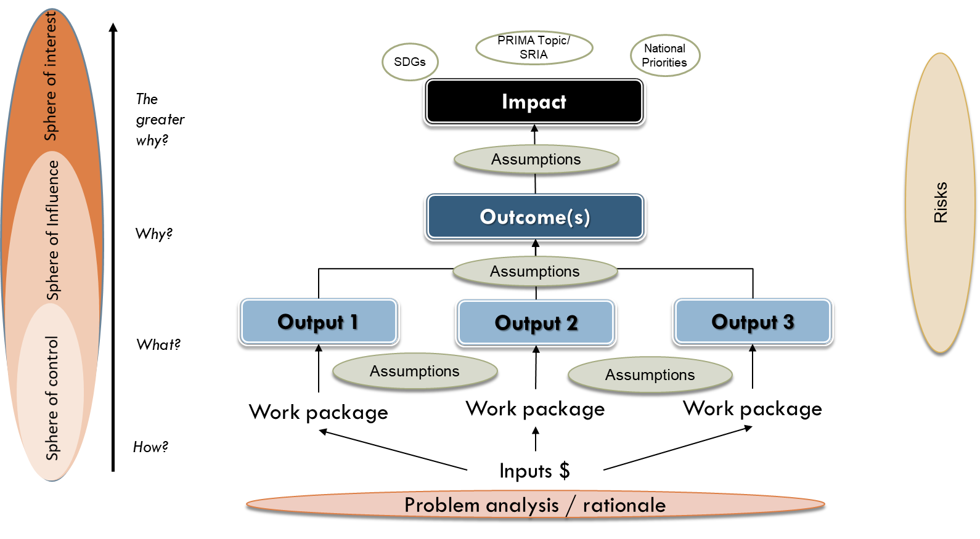
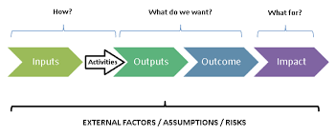
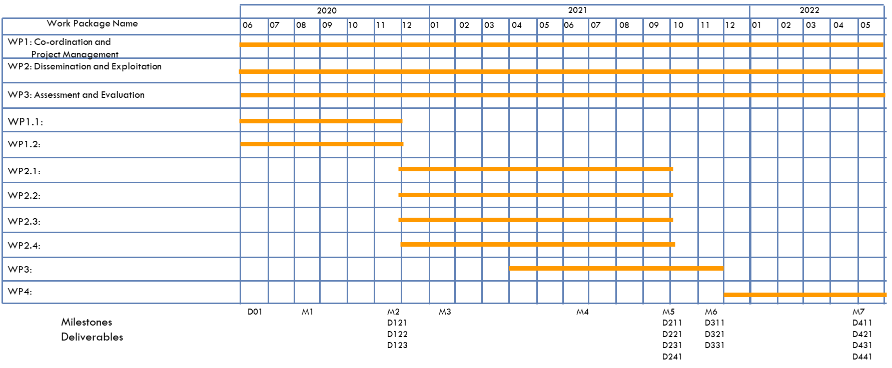
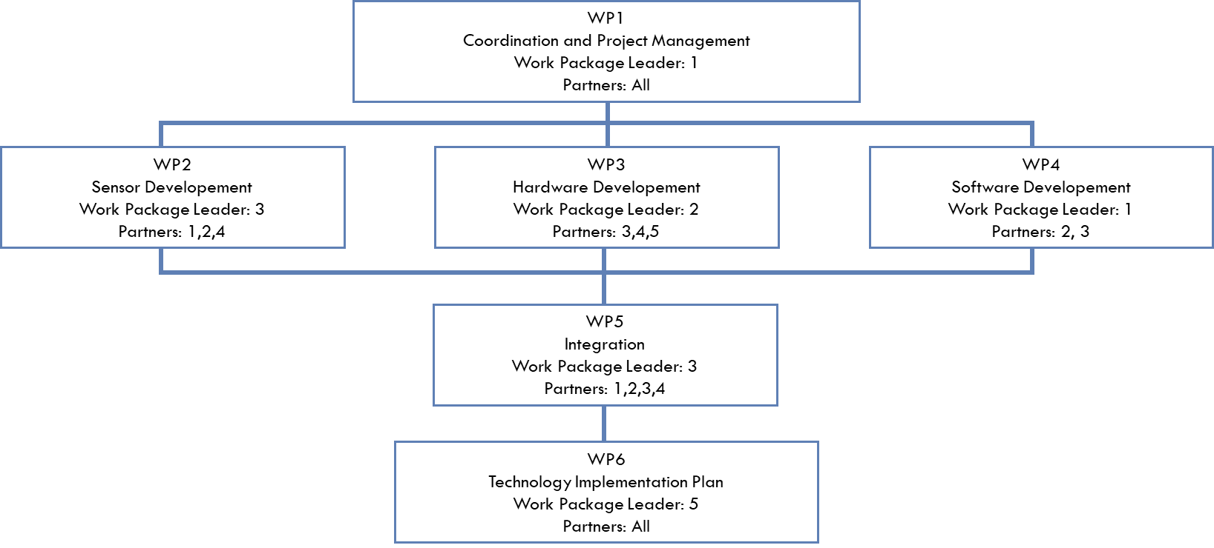
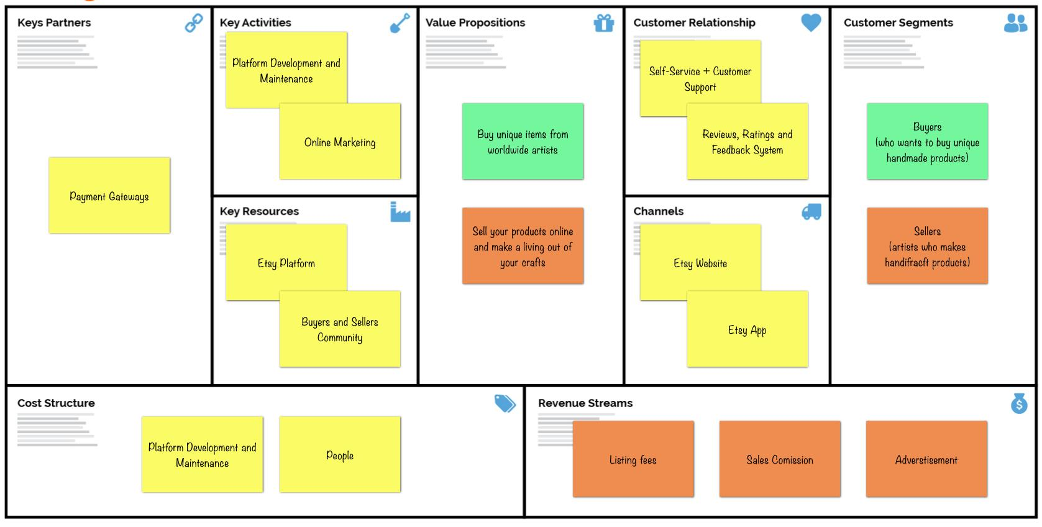
Theory of Change
Impact Pathway
Gantt Chart
Useful Diagrams
PERT Diagram
BMC
For demonstration purpose only. Not part of the PRIMA official template

Slide 14
Most Common Reasons for Failure
Weak project idea (novelty and applicability);
Low Relevance: unimportant problem – not aligned to donor priorities:
Weak consortium, partners overlapping, unjustified;
Lack of expertise (technical, management) and/or resources;
Unfocused approach; vague objectives;
Unrealistic: the amount of work proposed, objectives, absence of clear indicators/targets;
Uncertain long-term impact and/or lack of future direction;
Over-/ underestimated budget;
Poor/unclear language.
WHY DO WE FAIL?

Slide 15
General Remarks – Pre Proposal
Two Sections → Equal Scoring → Equal Attention.
Only 10 pages, use it precisely and concisely.
Don't waste space on the implementation/details.
Quantify, Quantify, Quantify, Quantify …
Use tables, figures, and diagrams, but not extensively.
Present dissemination, communication, and exploitation plan, in brief.
Show INTERDISCIPLINARY of PARTNERS, stakeholders, end users...
Show the NOVELTY (process, solution, methodology, presentation).
NETWORKING and SYNERGY
FIRST STAGE

Slide 16
Excellence (max. score /5)
Fit with the Scope and objectives of the PRIMA programme, the call topic, SRIA…;
Importance, Relevance/pertinence, and clarity of the Objectives;
Soundness of the Concept and credibility of the proposed Approach/Methodology.
Extent that the proposed work is beyond the State of the art, and demonstrates Innovation Potential.
Appropriate consideration of Interdisciplinary approaches and, where relevant, use of Stakeholder Knowledge.
SECTIONS REMAKRS

Slide 17
Impact (max. score /5)
The extent to which the Outputs of the project would contribute to several of the expected impacts mentioned in the AWP (Scores of the proposals will not depend on the number of expected impacts covered).
Mention Impacts not mentioned in the work plan, (enhance innovation capacity, create new market opportunities, strengthen competitiveness and growth of companies, address issues related to climate change or the environment, or bring other important benefits for society).
Quality of the proposed measures to: Exploit and disseminate the project results (incl. IPR management, Data management), Communication of the results.
SECTIONS REMAKRS

Slide 18
GEBERAL Advices!!
Keep the title/ acronym of the project SIMPLE, CATCHY
Avoid TOO GENERAL BACKGROUND
Be CONCISE and write specifically about your project proposal
Register on the platform and update information regularly;
Own check-list table;
Read the Guidelines, and the Call text carefully;
Provide ALL the information requested;
Check the PRIMA website regularly for updates/modifications (e.g. deadline extension).
TAKEAWAYS

Slide 19
TECHNICAL Advices!!
Engage external Stakeholders/end-users + Communication tools and activities.
Relevance of your Project to PRIMA SRIA, PRIMA Call, PRIMA Topic, EU Regulations.
Justify: applied technologies, sites and locations, partners…
Check Numbering and Consistency: partners’ order, deliverables, WPs, tasks…
Invent tools, diagrams, charts, instruments to present your idea.
Measurable KPIs, Quantify activities, deliverables, outputs.
Polish and clear your proposal to be more appealed (not so colorful, not black & white).
Contact Your National Contact Point.
TAKEAWAYS

Slide 20
PRIMA Programme is supported under Horizon 2020, the European Union’s Framework Programme for Research and Innovation.
Thank You, GOOD LUCK with PRIMA 2023!
Dr Mohamed Wageih
Project Officer
PRIMA – The Partnership for Research and Innovation in the Mediterranean Area
mohamed.wageih@prima-med.org
PrimaProgram
@PRIMAProgram
Prima Program
Prima-med YouTube

