Slide 1


SESSION 1: PRIMA PROGRAMME INTRODUCTION
Programme Overview and History
Application Forms
The PRIMA programme is an Art.185 initiative supported and funded under Horizon 2020, the European Union’s Framework Programme for Research and Innovation.

Slide 2

This training material has been prepared via PRIMA-IS for training purpose only.
1. PRIMA Overview & History
trategic Research and Innovation Agenda
raft - August 10th 2017

Slide 3

This training material has been prepared via PRIMA-IS for training purpose only.
Challenges in the Mediterranean Area: At a Glance
Climate change
Population growth and food security issues
Water scarcity and overexploitation of natural resources
Unsustainable agricultural practices
Agro-biodiversity loss
Lack of innovation in Mediterranean agro-food
value chains
trategic Research and Innovation Agenda
raft - August 10th 2017

Slide 4


















































































PRIMA can currently count on the participation of 19 Participating States, including: Algeria, Cyprus, Croatia, Egypt, France, Germany, Greece, Israel Italy, Jordan, Lebanon, Luxembourg, Malta, Morocco, Portugal, Slovenia, Spain, Tunisia, Turkey
GERMANY
LUXEMBOURG
FRANCE
SLOVENIA
CROATIA
ITALY
PORTUGAL
SPAIN
GREECE
TURKEY
TUNISIA
LEBANON
MALTA
CYPRUS
MOROCCO
ISRAEL
ALGERIA
JORDAN
EGYPT

Slide 5
This training material has been prepared via PRIMA-IS for training purpose only.
PRIMA Main Features
An article 185 initiative as the most suitable instrument to tackle global challenges of the Med region in an integrated way
Equal footing
Long-term commitment and orientation
Avoiding fragmentation and duplications in R&I
Focused on Research, Innovation and Adoption of innovation solutions
Definition of a common and MED-wide 10-year Strategic Research and Innovation Agenda (2018-2028)
Institutional relationships with MED stakeholders (end users, communities, enterprises, governments)
19 June 2017
Foundation under Spanish law
19 PSs members of Foundation
Financial contribution
€ 274,000 PSs
€ 220.000 EU

Slide 6
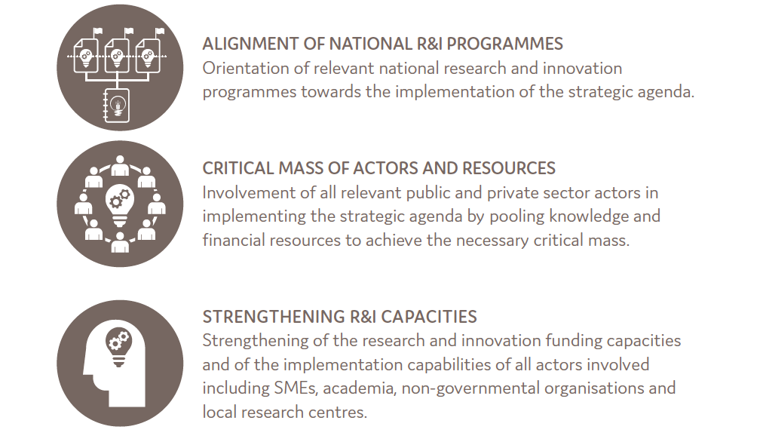
This training material has been prepared via PRIMA-IS for training purpose only.
How to address these challenges?
trategic Research and Innovation Agenda
raft - August 10th 2017

Slide 7
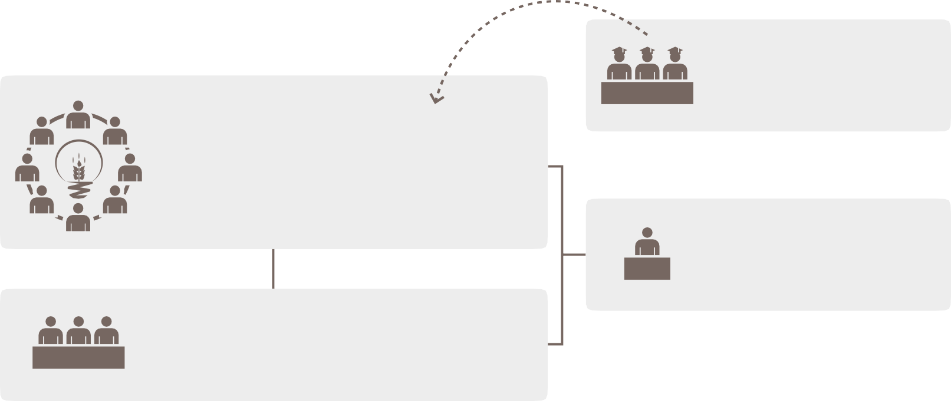
This training material has been prepared via PRIMA-IS for training purpose only.
PRIMA Foundation Governance
advice
Scientific
Advisory Committee
Board of Trustees
- Chair and Co-Chair
- PS Representatives
- EC, UfM as Observers
PRIMA Secretariat Barcelona
Steering Committee
PRIMA operates as an independent legal private entity
Financial contribution
€ 274,000 PS
€ 220.000 EU
19 June 2017
Foundation under Spanish law
19 PS members of Foundation

Slide 8







This training material has been prepared via PRIMA-IS for training purpose only.
Strategic Research and Innovation Agenda SRIA
The Strategic Research and Innovation Agenda
sets the technical and scientific basis of the PRIMA Programme
is the output of a process encompassing the collection of inputs from a wide range of sources, workshops, events involving experts and stakeholders from all sectors of society
identifies three thematic areas to address
Strategic Research and Innovation Agenda
Draft - August 10th 2017
The PRIMA programme is implemented by the PRIMA Foundation on the basis of Annual Work plans, based on the priorities described in the PRIMA Strategic Research and Innovation Agenda (SRIA)
Notes:
An on-line public consultation was also carried out during May and June 2017. most respondents considered that the PRIMA SRIA well identifies the most important Mediterranean challenges.

Slide 9
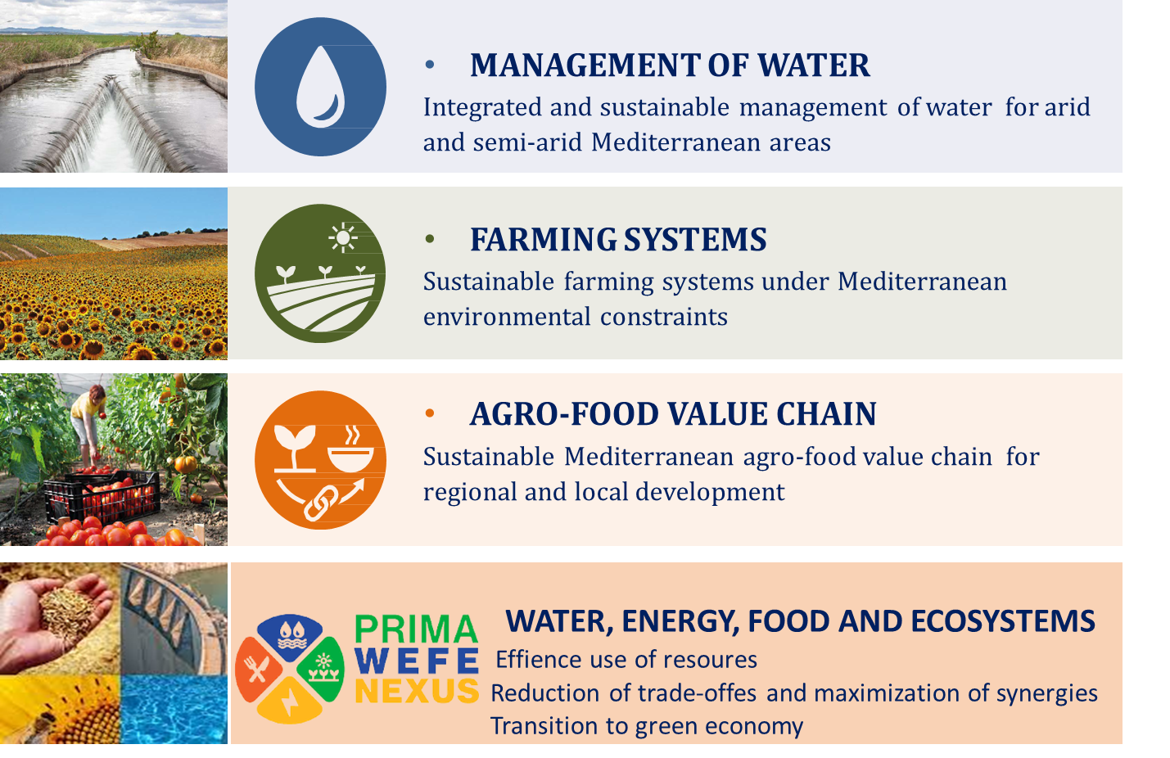
This training material has been prepared via PRIMA-IS for training purpose only.
FOUR Thematic Areas

Slide 10



This training material has been prepared via PRIMA-IS for training purpose only.
PRIMA IMPACTS
Economic Impacts
Social Impacts
Environmental Impacts
Increase in production and efficiency;
Access to new markets;;
Large-scale aggregate economic impacts.
Political stabiliy
and reduced migration.
Biodiversity conservation;
Sustainable farming practices.

Slide 11
This training material has been prepared via PRIMA-IS for training purpose only.
PRIMA CALLS STRUCTURE
SECTION 1
Actions and activities organised, managed and funded by PRIMA-IS.
SECTION 2
Actions selected following transnational open and competitive calls for proposals organised by PRIMA-IS and funded by the national funding bodies of PS (providing financial support mainly in the form of grants).

Slide 12
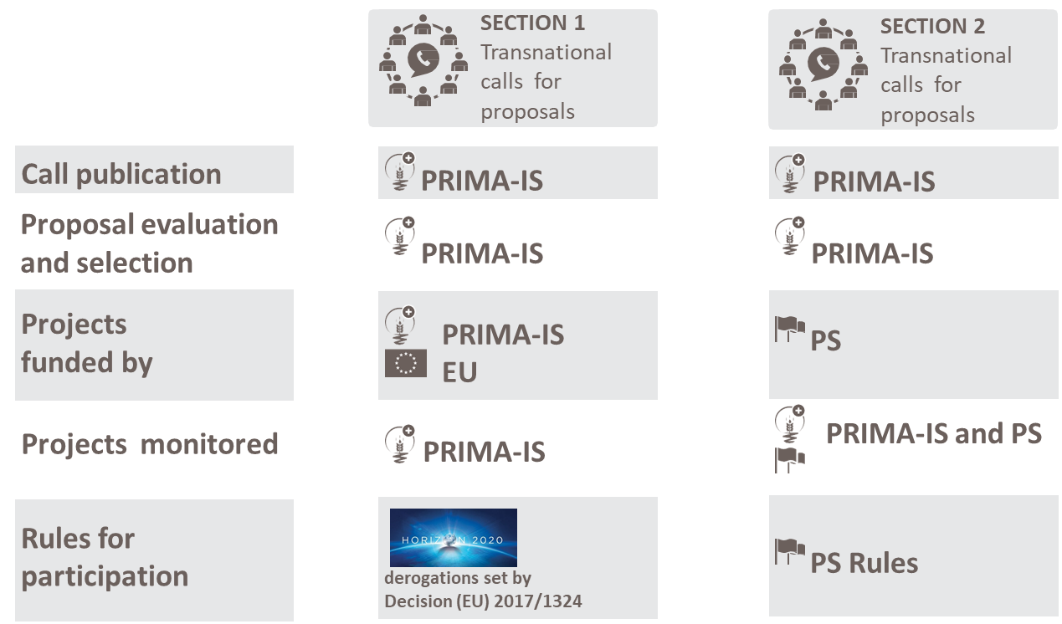
This training material has been prepared via PRIMA-IS for training purpose only.
PRIMA Programme Structure

Slide 13
This training material has been prepared via PRIMA-IS for training purpose only.
Type of Actions
RIA - Research and Innovation Action | IA - Innovation Action | CSA - Coordination and Support Actions
Funding available for collaborative research projects tackling clearly defined challenges which can lead to the development of new knowledge or new technology. Funding Rate: 100% TRL: 3-5 Two Stages Submission | Funding available for closer-to-the-market activities including prototyping, testing, demonstrating, piloting, scaling-up etc. for new or improved products, processes or services. Funding Rate: 70% (100% for no-profit entities) TRL: 5-8 Two Stages Submission | Funding for activities coordinating or supporting research actions and strategies, such as networking and exchange actions Funding Rate: 100% Single Stage Submission

Slide 14
This training material has been prepared via PRIMA-IS for training purpose only.
Technology Readiness Levels (TRLs)

Slide 15
This training material has been prepared via PRIMA-IS for training purpose only.
2. PRIMA APPLICATION & PROCEDURE
trategic Research and Innovation Agenda
raft - August 10th 2017

Slide 16
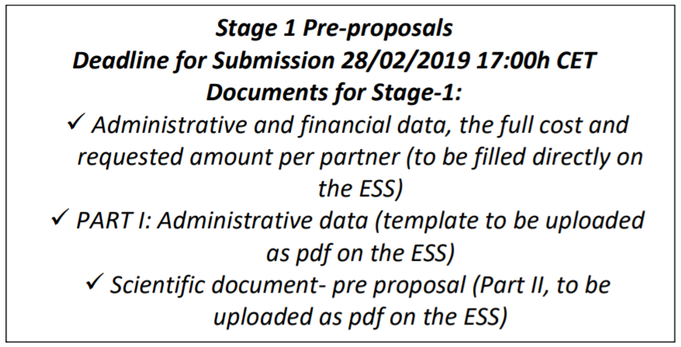
This training material has been prepared via PRIMA-IS for training purpose only.
Content and Structure of the Pre-proposal – STAGE 1
General Guidelines
XX/XX/XXXX

Slide 17
This training material has been prepared via PRIMA-IS for training purpose only.
Content and Structure of the Pre-proposal – STAGE 1
General information about the project – PART I
The pre-proposal must be submitted online on the evaluation system (ANR).
The link will be announced on the PRIMA website in the corresponding section of the calls and will be open 1 month before the deadline for submission
Main administrative data have to be fill directly online (details in Annex of the guidelines for applicants: how to use the website with screenshots….)
Submit the pdf of the pre proposal following the template (available on PRIMA website)

Slide 18
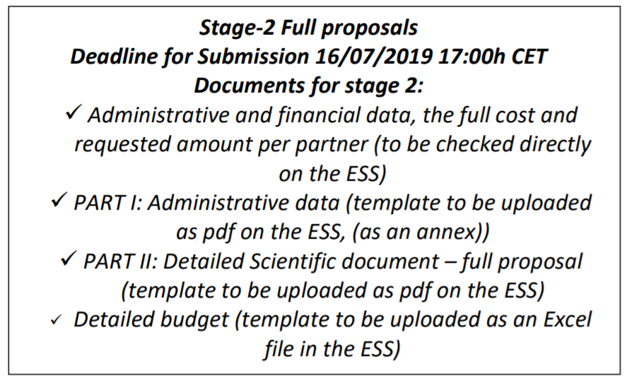
This training material has been prepared via PRIMA-IS for training purpose only.
Content and Structure of the Full Proposal – STAGE 2
XX/XX/XXXX
trategic Research and Innovation Agenda
raft - August 10th 2017

Slide 19

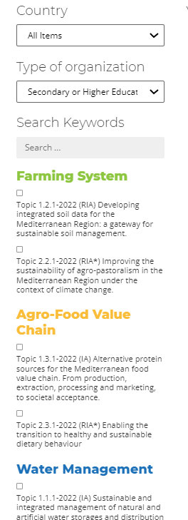
This training material has been prepared via PRIMA-IS for training purpose only.
PRIMA Website, where to find all these data?
CALL SECTION
- Information and guidelines for each call
- Templates
- Link to submission website (one link per call)
PARTNERING TOOL
Applicants can post and read offers to look for partners
EXPERT REGISTRATION TOOL
To register as expert to take part in the evaluation of the proposals submitted to PRIMA calls
trategic Research and Innovation Agenda
raft - August 10th 2017
http://prima-med.org/

Slide 20
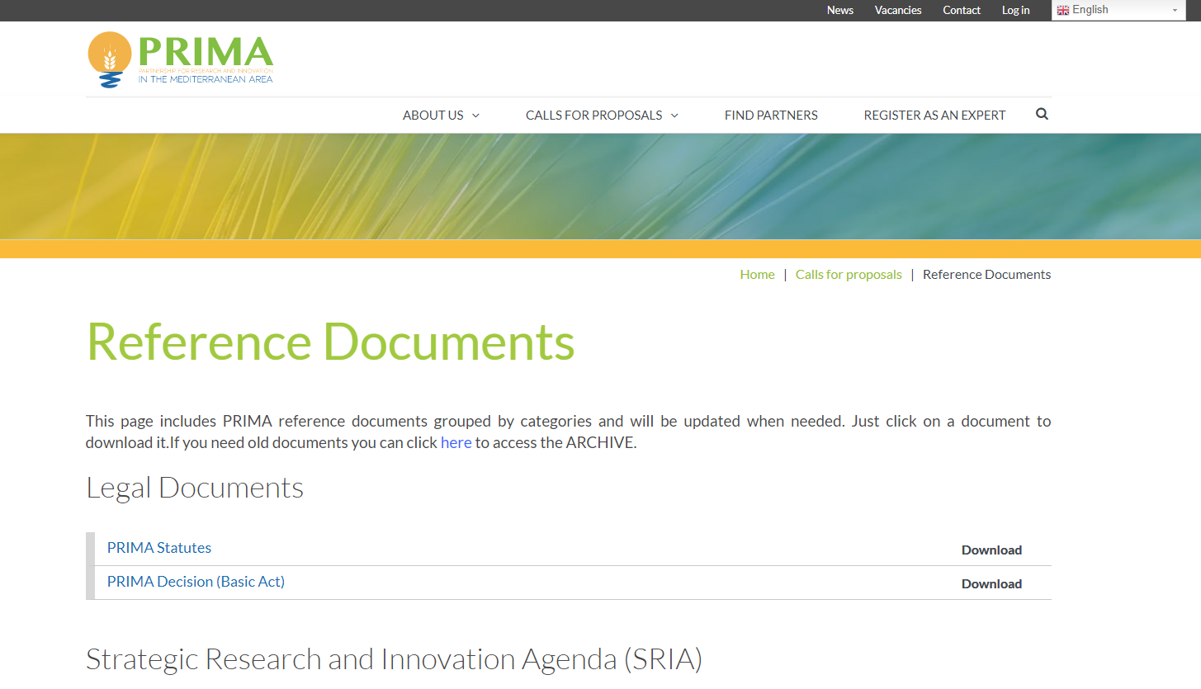
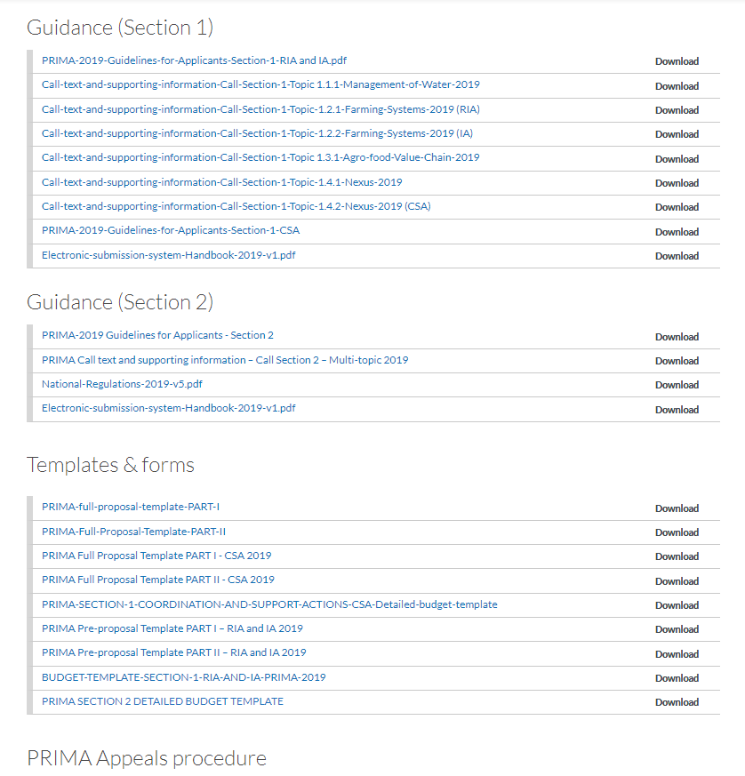
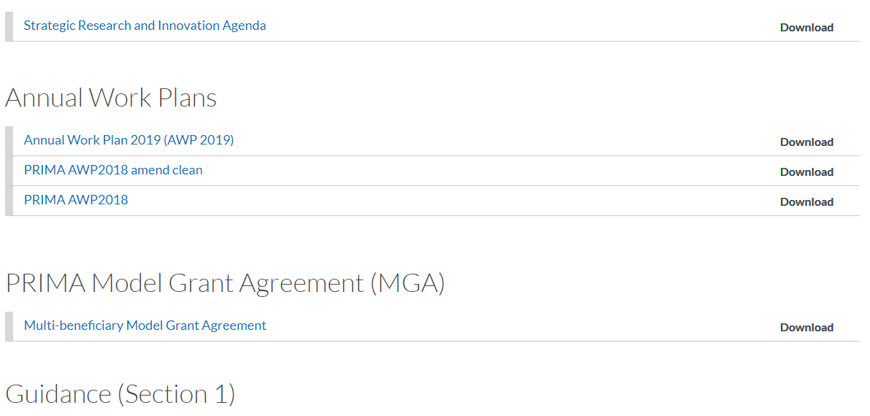
This training material has been prepared via PRIMA-IS for training purpose only.
PRIMA Website, where to find all these data?

Slide 21





END OF SESSION ONE
THANK YOU FOR YOUR ATTENTION
OMAR AMWAI
DEPUTY DIRECTOR
PRIMA – The Partnership for Research and Innovation in the Mediterranean Area
PrimaProgram
@PRIMAProgram
Prima Program
Prima-med YouTube

