Slide 1


SESSION FOUR: How to Write A Competitive PRIMA Proposal?
Guideline, Documents and Analyze PRIMA Topics
Main Sections of Part I (Admin)
The PRIMA programme is an Art.185 initiative supported and funded under Horizon 2020, the European Union’s Framework Programme for Research and Innovation.

Slide 2

This training material has been prepared via PRIMA-IS for training purpose only.
1. Guidelines, Documents and Analyze PRIMA Topics
trategic Research and Innovation Agenda
raft - August 10th 2017

Slide 3
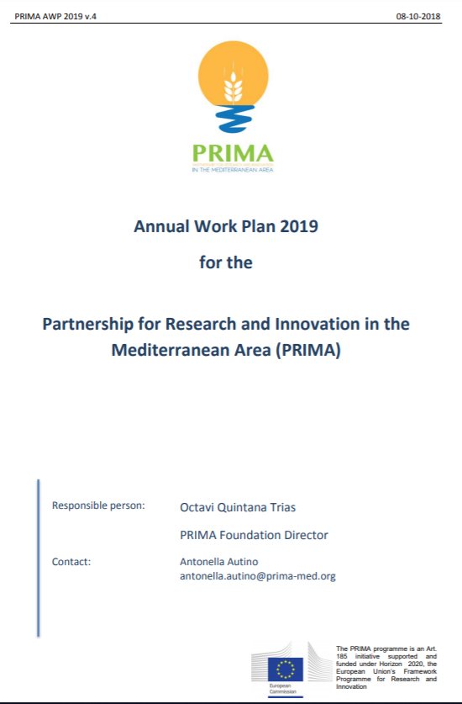
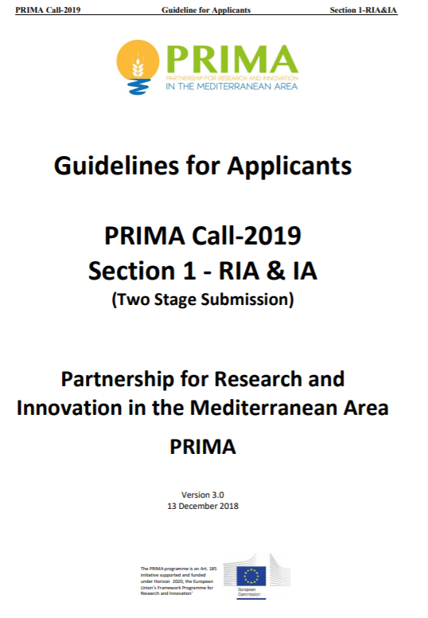
This training material has been prepared via PRIMA-IS for training purpose only.
PRIMA guidelines and documents
Call reference document
Official announcement
PRIMA Introduction
Structure of the Call
Topics, funding, type of the action
Annexes and other docs
Instructions: How to apply?
Eligibility and admissibility criteria
Evaluation criteria
Main sections (Pre and Full)

Slide 4
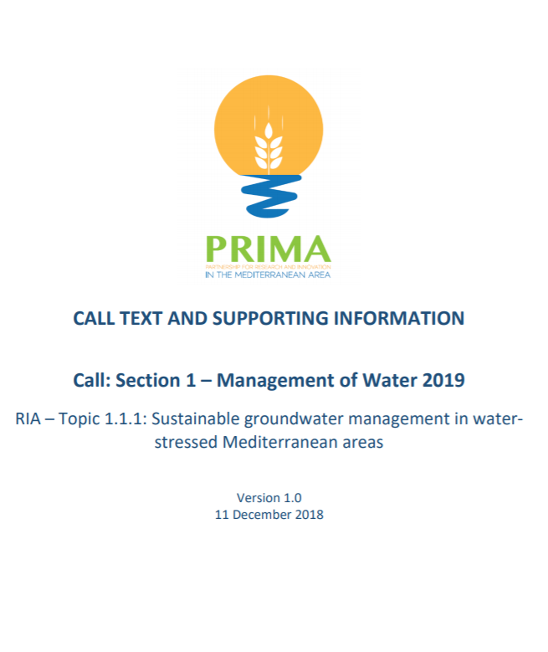
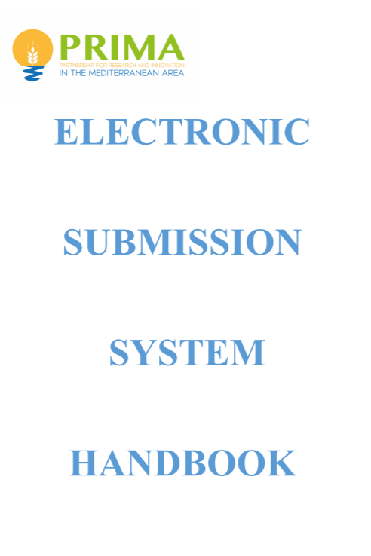
This training material has been prepared via PRIMA-IS for training purpose only.
PRIMA guidelines and documents
Scientific description of each topic:
  Challenge
  Scope
  Expected Impact
How to use the submission system:
  Complete your proposal
  Consortium builder
  Fill Financial data
  Project Summary
  Upload Part I, II, budget sheet
  Submission: at the deadline!!

Slide 5

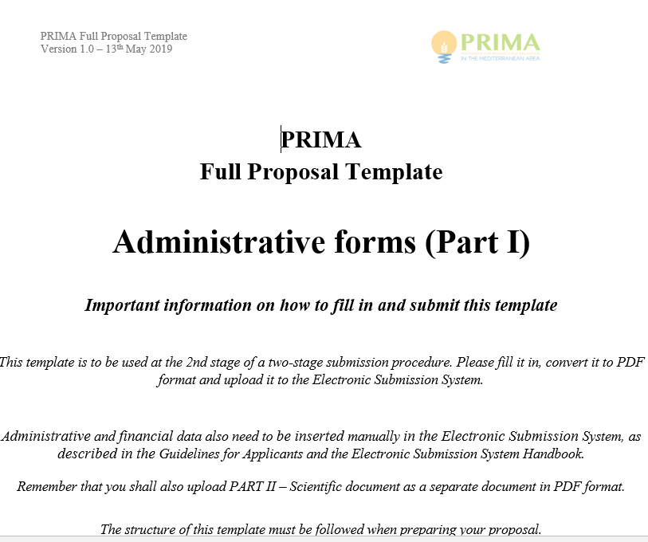
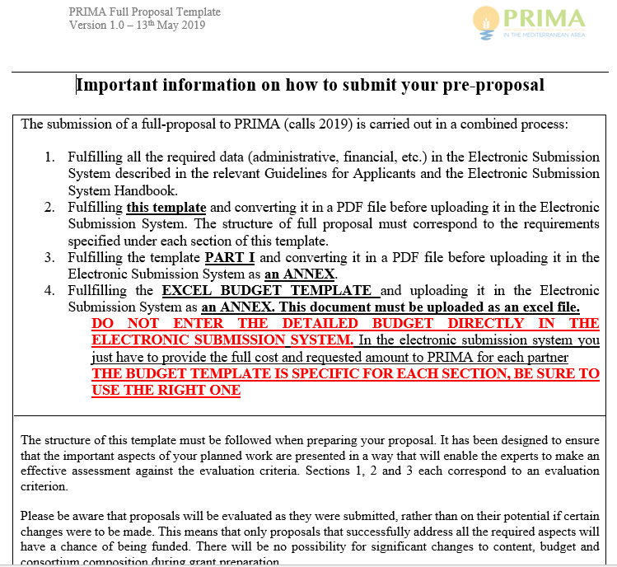
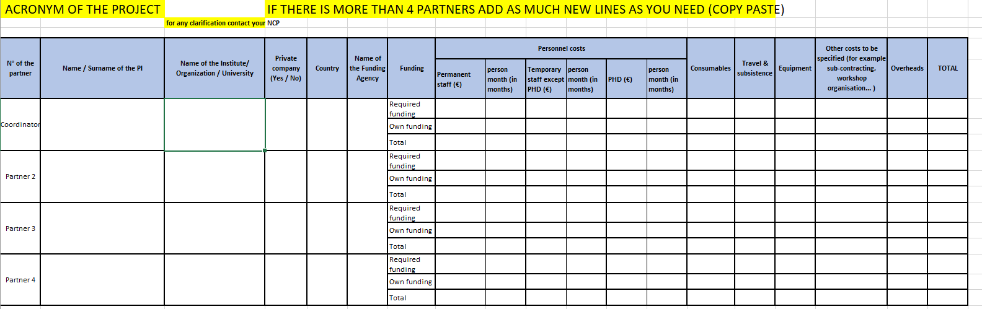
This training material has been prepared via PRIMA-IS for training purpose only.
PRIMA guidelines and documents
Essential for Section 2
National regulation of each PRIMA National Funding Agencies, contacts,…
Communicate with your corresponding NCP!!
Templates
  Part I (admin part): stage 1&2
  Part II (scientific part) Stage 1&2
  Detailed Budget sheets, Stage 2 only (Section 1 and Section 2)

Slide 6
This training material has been prepared via PRIMA-IS for training purpose only.
Analyze PRIMA topic

Slide 7
This training material has been prepared via PRIMA-IS for training purpose only.
Practices
2019
How to read and analyze PRIMA topic?
(http://prima-med.org/wp-content/uploads/2018/12/PRIMA-Call-text-and-supporting-information-Call-Section-1-Topic-1.2.2-%E2%80%93-Farming-Systems-2019.pdf
http://prima-med.org/wp-content/uploads/2018/12/PRIMA-Call-text-and-supporting-information-Call-Section-1-Topic-1.3.1-%E2%80%93-Agro-food-Value-Chain-2019.pdf)
PRIMA CALL 2019 – section 1 – FOOD/ Farming IAs topics

Slide 8
This training material has been prepared via PRIMA-IS for training purpose only.
How to read PRIMA topic?
2019
I. The Topic Title
IA – Topic 1.3.1: Implementation of analytical tools and digital technology to achieve traceability, authenticity control of traditional Mediterranean foods
Select the topic Ref # on the submission system
Applied solutions
Innovation Action
Be specific, selective, not diffused
High TRL
Scope/specific objective of the topic
Engagement of Stakeholders and private sector
Q: 2.2.2?
Q: 1.4.1?

Slide 9
This training material has been prepared via PRIMA-IS for training purpose only.
How to read PRIMA topic?
2019
Challenges
The Mediterranean traditional food ……………………………………………………… …………………………………….. in food processing, preparation and nutrition requirements. ……….. valorization of Mediterranean animal breeds and plant varieties, as sources of foods and natural bioactive compounds, requires their unequivocal traceability and characterization, based on state-of-the-art methods and technologies which univocally define their Mediterranean origin in a global context, as well as their quality and safety. ………The creation of reference databases would foster the necessary harmonization of the analytical methods and data validation among different laboratories, two stringent requirements for the creation of a trans-national authenticity and traceability system that specifically address the identification of animal breeds, plant varieties, geographical origin and production protocols characterizing….

Slide 10
This training material has been prepared via PRIMA-IS for training purpose only.
Section 1 - Thematic Area 3- Agro-food value chain
2019
SCOPE
Development and implementation of analytical tools and technologies to achieve traceability, and to confirm authenticity of Mediterranean foods.
Providing a robust certification and control bodies as well as creating trans-national networks of laboratories, validating and harmonizing protocols, sharing open-data on food products of the Mediterranean tradition.
Building capacities of key enabling technologies.
Optimising the use of pre-existing databases and networking

Slide 11


This training material has been prepared via PRIMA-IS for training purpose only.
Section 1 - Thematic Area 3- Agro-food value chain
2019
IMPACT
Improve confidence of consumers;
Assessing food traceability and safety.
Increased added-value for Mediterranean food products;
Foster joint integrative activities with existing data base networks & infrastructures in the health & food domain;
Improve harmonization and data interoperability

Slide 12
This training material has been prepared via PRIMA-IS for training purpose only.
2. Part I (Admin) – Pre Proposal and Full Application
trategic Research and Innovation Agenda
raft - August 10th 2017

Slide 13
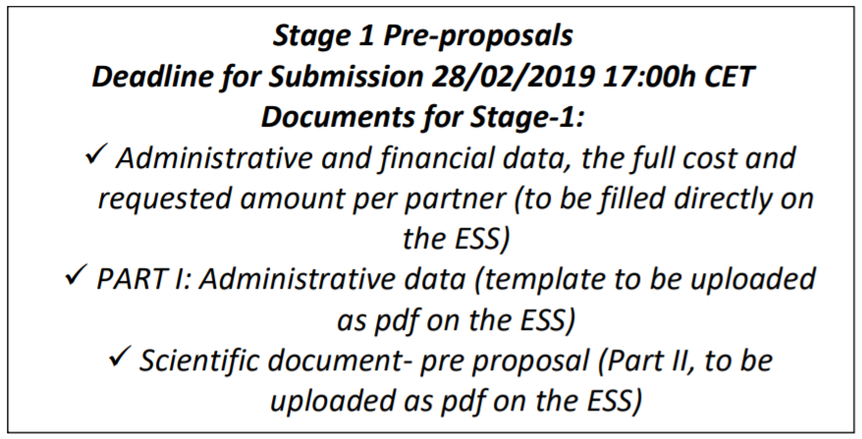
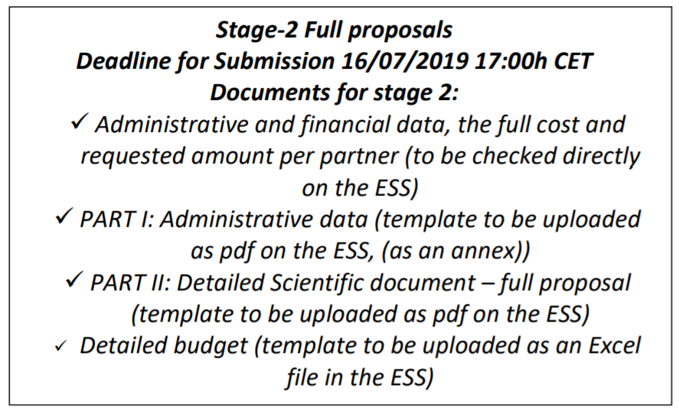
This training material has been prepared via PRIMA-IS for training purpose only.
Main Sections of Part I
Online
Online
Uploaded doc
Uploaded doc

Slide 14
This training material has been prepared via PRIMA-IS for training purpose only.
Main sections of Part I – the document
1. Administrative data of participant organizations
2. General information on the pre-proposal
3. Ethics issues table
4. Call specific questions
Attention: Between Stage-1 and Stage-2, NO MODIFICATIONS are allowed in the consortium composition (Organizations, Coordinator and PIs), budget and scientific objectives. In Section 2, NFAs might request some adjustments/modifications during Stage 2 (under condition).

Slide 15
This training material has been prepared via PRIMA-IS for training purpose only.
1. Administrative data of participant organizations
The pre-proposal must be submitted online on the evaluation system (ANR). The link will be announced on the PRIMA website in the corresponding section of the calls and will be open 1 month before the deadline.
Main administrative data have to be fill directly online (details in Annex of the guidelines for applicants: how to use the website with screenshots….)
Submit the pdf of the pre proposal following the template (available on PRIMA website)

Slide 16
This training material has been prepared via PRIMA-IS for training purpose only.
2. General information on the pre-proposal
Section:
Call:
Topic:
Type of action:
Duration in months:
Free keywords | Enter any words you think give extra detail of the scope of your proposal (max 200 characters)
Abstract: | Short summary (max. 2,000 characters, with spaces) to clearly explain: • the objectives of the proposal • how they will be achieved • their relevance to the specific call and topic against which the proposal is submitted Will be used as the short description of the proposal in the evaluation process and in communications with the programme management committees and other interested parties • Do not include any confidential information. • Use plain typed text, avoiding formulae and other special characters.
Questions to be answered by the coordinator:
Project submitted in previous EU calls?
Verification of the financial capacity (only for private entities)
Total budget requested to PRIMA (on the submission website each partner must give the total cost of the project and the requested amount to PRIMA)
Etc….

Slide 17





END OF SESSION FOUR
THANK YOU FOR YOUR ATTENTION
Dr. Mohamed Wageih
Project Officer
PRIMA – The Partnership for Research and Innovation in the Mediterranean Area
mohamed.wageih@prima_med.org
PrimaProgram
@PRIMAProgram
Prima Program
Prima-med YouTube

