Slide 1




Submission and evaluation of proposals Practical aspects
OMAR AMAWI,
DEPUTY DIRECTOR
@PRIMAPROGRAM #PRIMAInfoday
The PRIMA programme is an Art. 185 initiative supported and founded under Horizon 2020, the European Union’s Framework Programme for Research and Innovation
Info day Germany 15 February 2022

Slide 2



Rules for participation RIA /IA
  3 COUNTRIES MINIMUM
    ONE PS EU
    ONE PS NON EU
  ONE PS EU OR PS NON EU
  4 LEGAL ENTITIES MINIMUM
    ONE PS EU
    TWO PS NON EU
  ONE PS EU OR PS NON EU
&
  EXAMPLES:
  MALTA-GREECE-MOROCCO-EGYPT = ELIGIBLE
  MALTA-GREECE-MOROCCO Entity 1- MOROCCO Entity 2 = ELIGIBLE
  MALTA-GREECE-FRANCE-MOROCCO = NOT ELIGIBLE (only 1 entity from the south)
  MALTA Entity 1-MALTA Entity 2- MOROCCO Entity 1- MOROCCO Entity 2 = NOT ELIGIBLE (only 2 countries)

Slide 3

Where to find the information: PRIMA WEBSITE
Prima-med.org
On the website you will find all relevant updates, documents and information on the programme, including.
RESEARCH AND INNOVATION : CALL SECTION
- Information and guidelines for each call
- Templates
- Link to submission website (one link per call)
PARTNERING TOOL
Applicants can post and read offers to look for partners
EXPERT REGISTRATION TOOL
To register as expert to take part in the evaluation of the proposals submitted to PRIMA calls

Slide 4

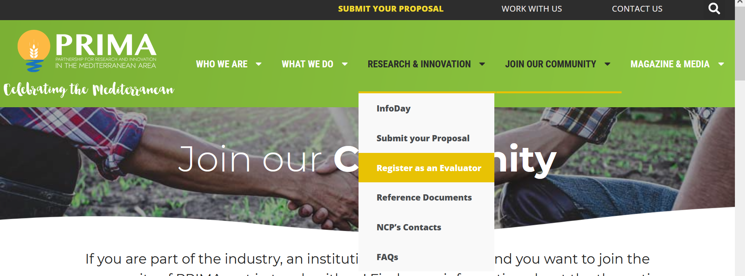
How to find partners
Applicants can post and read offers to look for partners
How to become a PRIMA evaluator

Slide 5
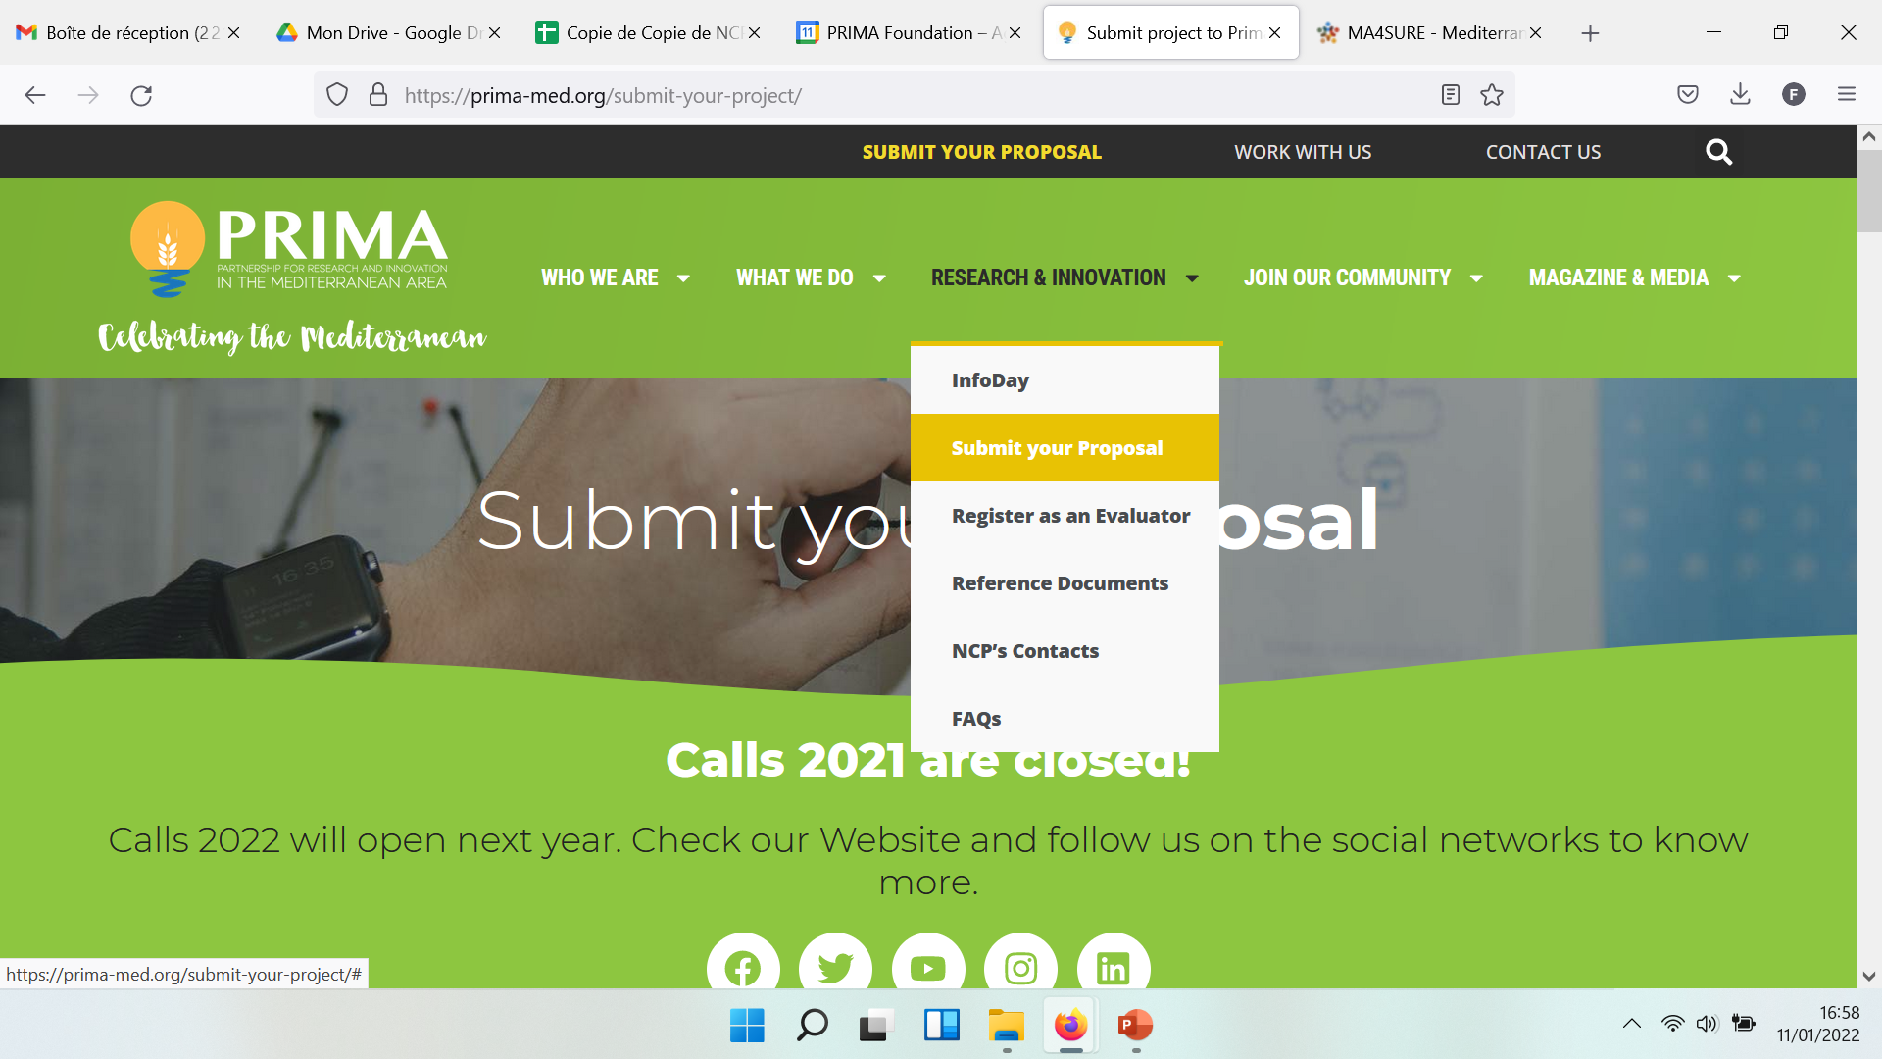
Call information : submit your proposal

Slide 6

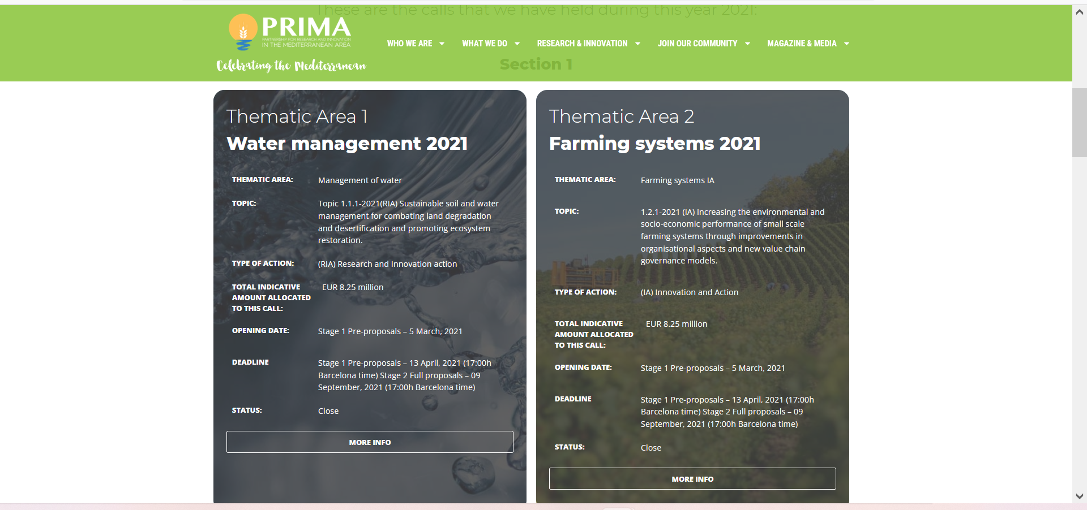
List of the topics and short description
TITLE OF THE PRESNTATION

Slide 7
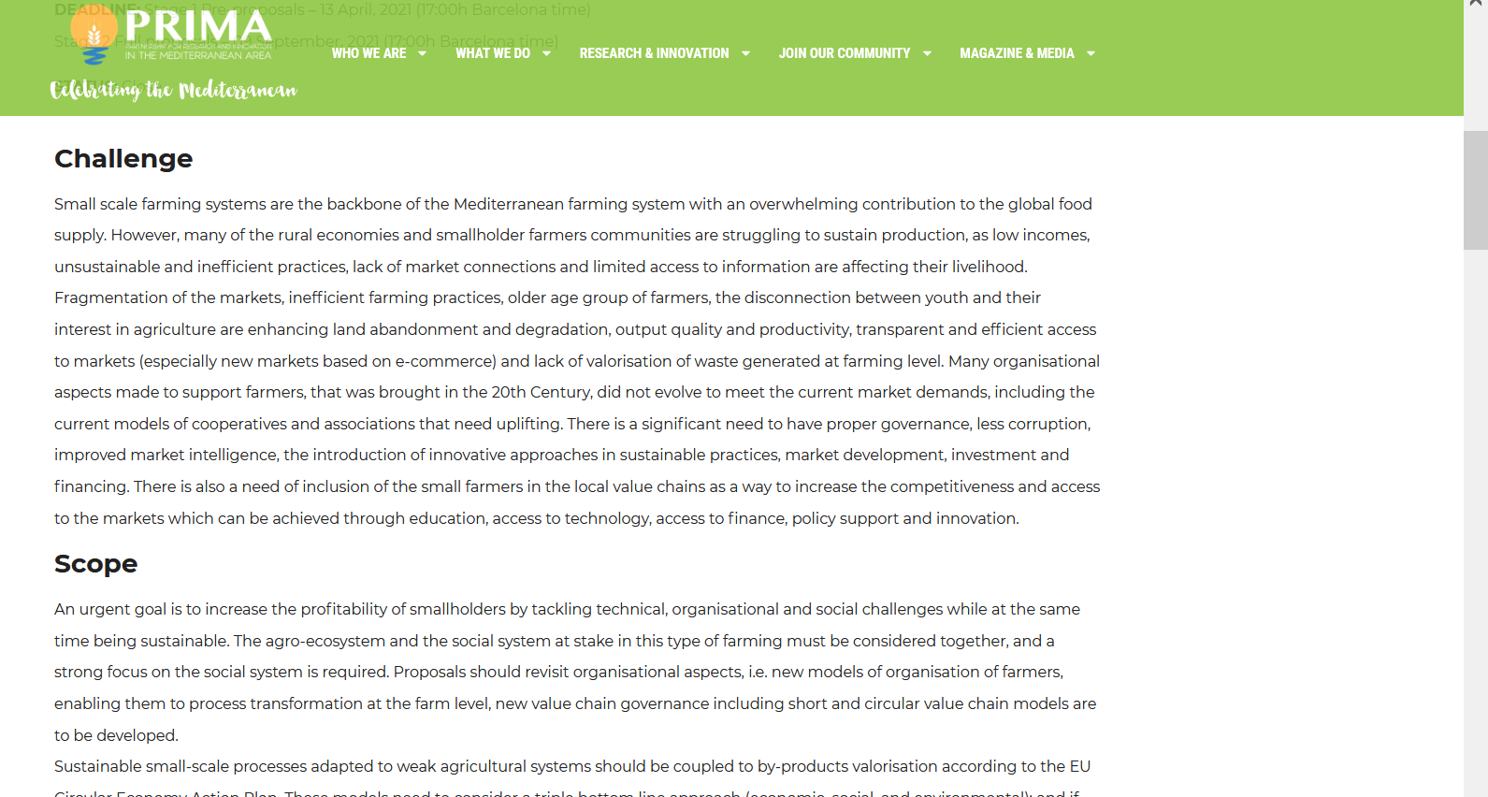

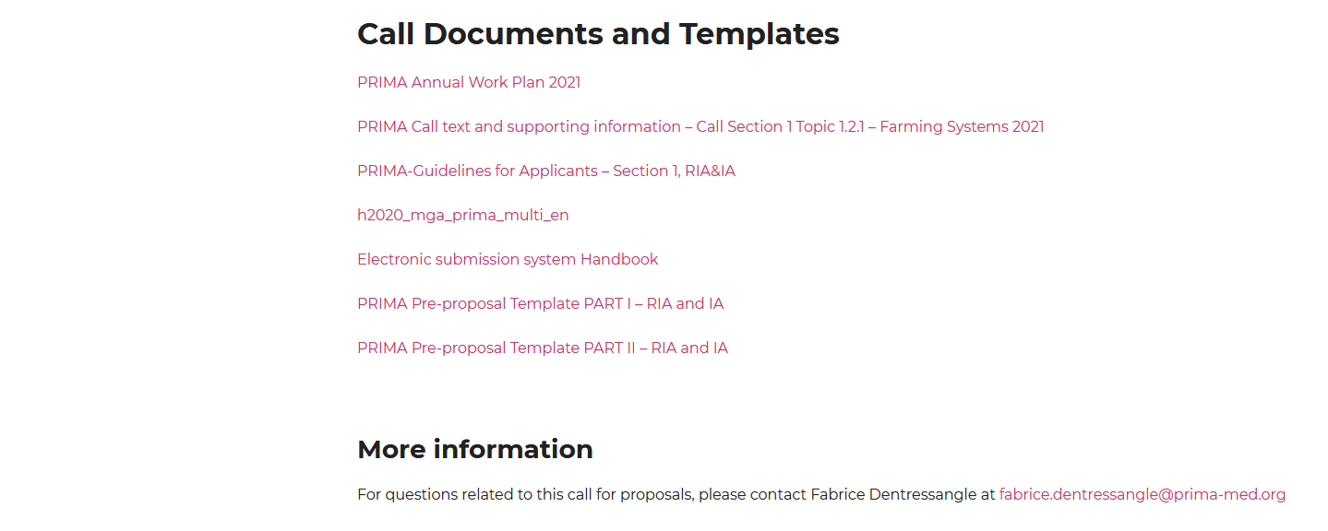
Full topic description with links to the templates
To access the Electronic submission website
Active 1 month before the deadline

Slide 8
Start the submission process on the ANR platform

Slide 9
Electronic submission system and HANDBOOK
Information and type of documents you have to upload

Slide 10
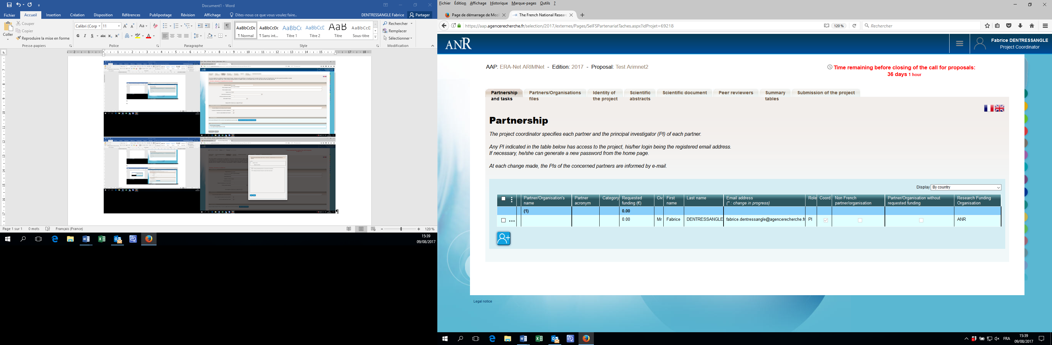
Click here to ADD partners

Slide 11
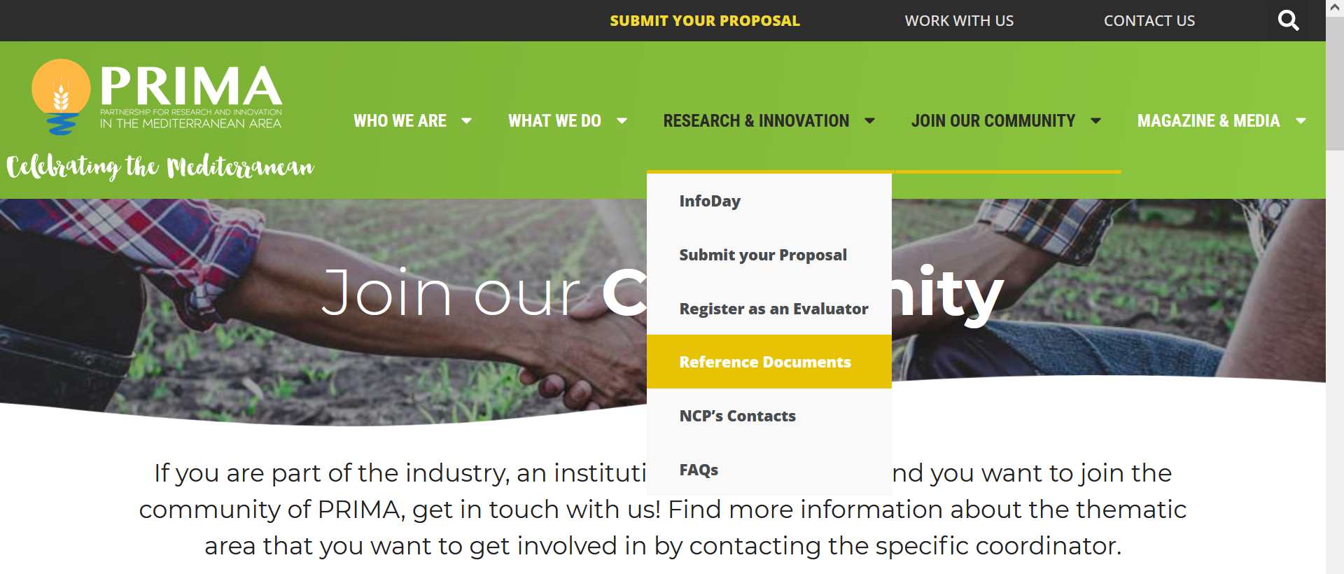
Guidelines, call text, national regulations, templates…. are also available in the section Reference documents of the PRIMA website

Slide 12
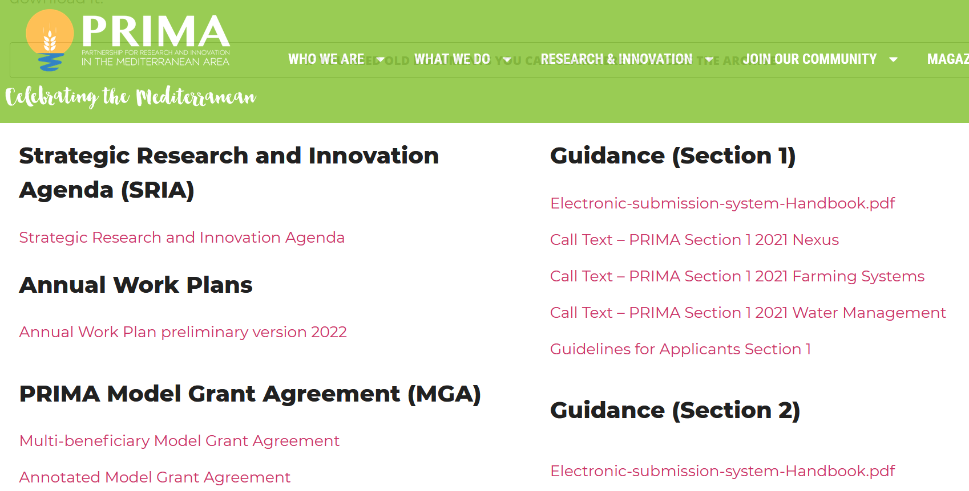
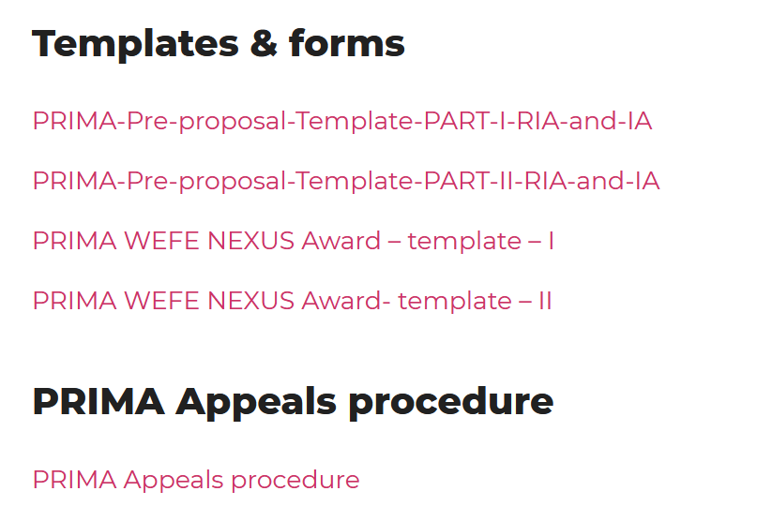
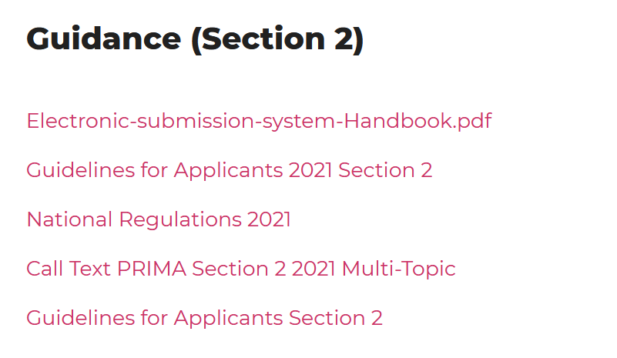

Slide 13
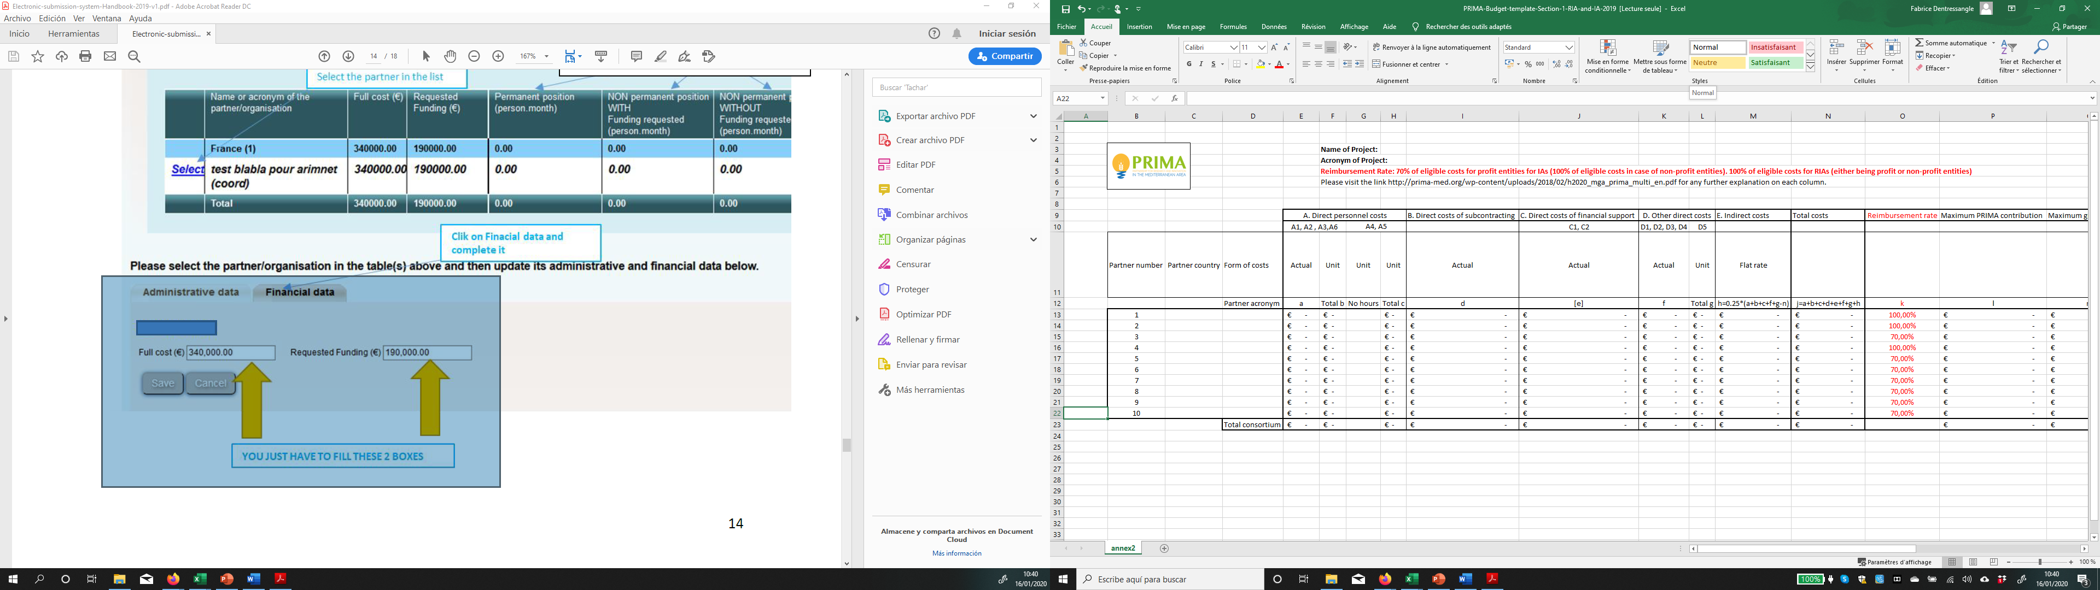
Checklist to submit your proposal
Have an eligible consortium & fulfill all the admin data on the submission platform
Submit all the required documents:
  Part I : Administrative data
  Part II. Technical annex
Budget: global & online stage 1
Detailed stage 2 Excel file
TITLE OF THE PRESNTATION

Slide 14


Content and structure of the pre-proposal
The pre-proposal must be submitted online on the evaluation system (ANR)
The link will be announced on the PRIMA website in the corresponding section of the calls and will be open 1 month before the deadline for submission
Main administrative data have to be fill directly online (details in Annex of the guidelines for applicants: how to use the website with screenshots….)
Submit the pdf of the pre proposal following the template (available on prima website)

Slide 15

General information about the project
Section:
Call:
Topic:
Type of action:
Duration in months:
Free keywords | Enter any words you think give extra detail of the scope of your proposal (max 200 characters)
Abstract: | Short summary to clearly explain: • the objectives of the proposal • how they will be achieved • their relevance to the specific call and topic against which the proposal is submitted Will be used as the short description of the proposal in the evaluation process and in communications with the programme management committees and other interested parties • Do not include any confidential information. • Use plain typed text, avoiding formulae and other special characters.
Questions to be answered by the coordinator:
Project submitted in previous EU calls?
Verification of the financial capacity (only for private entities)
Total budget requested to PRIMA (on the submission website each partner must give the total cost of the project and the requested amount to PRIMA)
Etc….

Slide 16
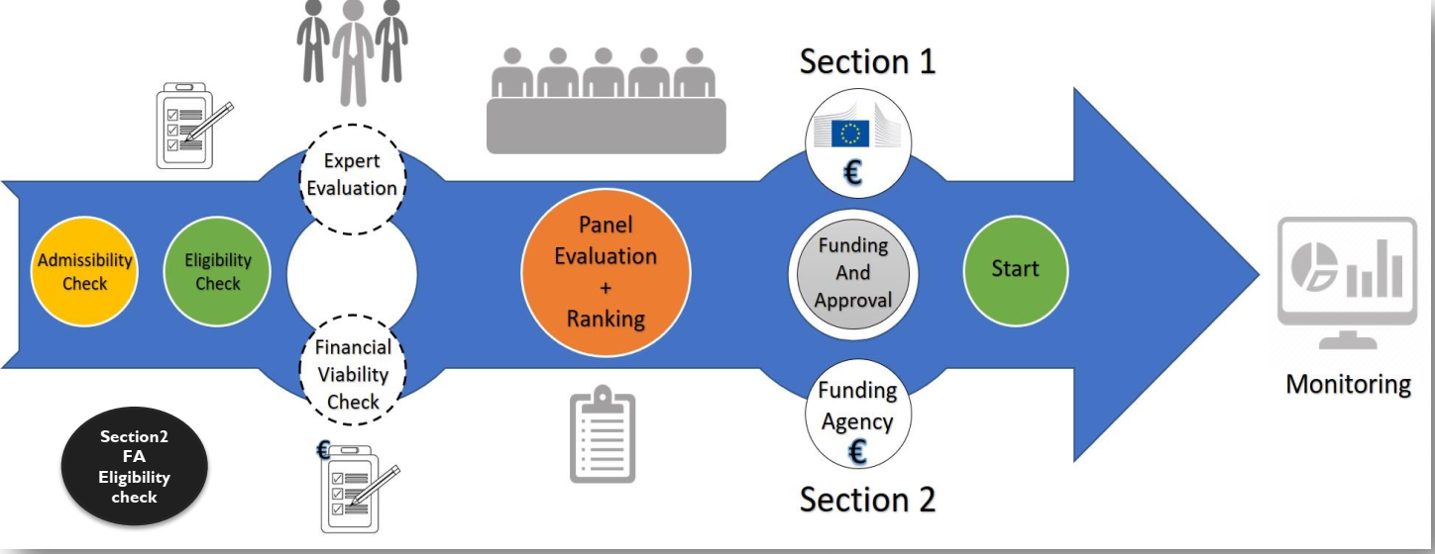

Evaluation process
Each proposal is evaluated by 3 independent experts and ranked by
consensus by the evaluation panel during a meeting

Slide 17
Evaluation Criteria
H2020 CRITERIA:
  EXCELLENCE / 5 points
  IMPACT / 5 points
  QUALITY AND EFFICIENTY OF THE IMPLEMENTATION (Only for step 2) / 5 points
For IA the criteria “impact” has a weight of 1.5
Thresholds:
Step 1: 4 points for each criteria Step 2: 3 points for each criteria
          and at least 10/15 in total

Slide 18
Evaluation Criteria
Excellence | Impact | Quality & Efficiency of the implementation
Clarity and pertinence of the objectives; Soundness of the concept, and credibility of the proposed methodology; Fit with the scope and objectives of the PRIMA programme and the call topic description; Extent that the proposed work is beyond the state of the art, and demonstrates innovation potential (e.g. ground-breaking objectives, novel concepts and approaches, new products, services or business and organizational models) Appropriate consideration of interdisciplinary approaches and, where relevant, use of stakeholder knowledge and gender dimension in research and innovation content. | The extent to which the outputs of the project would contribute to one or several of the expected impacts mentioned in this document under the relevant topic. Scores of the proposals will not depend on the number of expected impacts covered. Any substantial impacts, even if not mentioned in this document, that would enhance innovation capacity, create new market opportunities, strengthen competitiveness and growth of companies, address issues related to climate change or the environment, or bring other important benefits for society; Quality of the proposed measures to: Exploit and disseminate the project results (including management of IPR), and to manage research data where relevant. Communicate the project activities to different target audiences. | Quality and effectiveness of the work plan, including extent to which the resources assigned to work packages are in line with their objectives and deliverables; Appropriateness of the management structures and procedures, including risk and innovation management; Complementarity of the participants and extent to which the consortium as whole brings together the necessary expertise; Appropriateness of the allocation of tasks, ensuring that all participants have a valid role and adequate resources in the project to fulfil that role.

Slide 19
Recommandations
Don´t wait the last minute. Simple process but takes time!
Be sure to submit PART I (and all the requested documents)
For section 2: Each partner must check his eligibility with his NCP before submitting a proposal

Slide 20






Thank you
@PRIMAPROGRAM #PRIMAInfoDay
The PRIMA programme is an Art. 185 initiative supported and founded under Horizon 2020, the European Union’s Framework Programme for Research and Innovation
PrimaProgram
@PRIMAProgram
Prima Program
@prima_foundation_med
Prima-med YouTube
https://prima-med.org/

