Slide 1
COMPETITIVE RESEARCH PROPOSAL FOR PRIMA PROGRAMME
PRIMA-JORDAN Capacity Building Workshop
January 2023
The PRIMA programme is an Art.185 initiative supported and funded under Horizon 2020, the European Union’s Framework Programme for Research and Innovation.

Slide 2
PRIMA ACHIEVEMENTS BOARD (2018-2022)
2,400+
21K+
ALL
202
# of total eligible submissions
# of participating entities
PRIMA PS received funds
# of funded projects (16 MPC coordinators)
286 M€
28.5%
20%
1,900+
Total Budget Allocated
MPC Total Budget Share
Budget Share of Private Sector
# of Total Beneficiaries
49
86
57
10
# of Funded Projects -Water
# of Funded Projects -Farming
# of Funded Projects –Agro Food
# of Funded Projects -Nexus

Slide 3
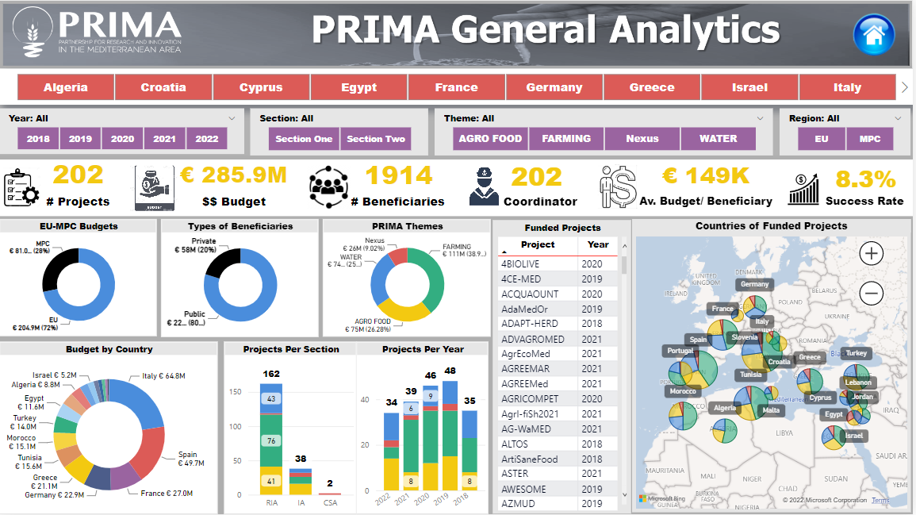
PRIMA OVER THE YEARS
Achievements

Slide 4
JORDAN ACHIEVEMENTS BOARD (2018-2022)
500
665
21
26
# of total eligible submissions
# of participating entities
# of Funded Projects (out of 202 funded)
# of Jordan Beneficiaries
3.9 M€
150 K€
4.2%
23%
Total Allocated Budget – Jordan Beneficiaries
Average Allocated Budget/ JO Entity
Jordan Success Rate
Budget Share of JO Private Sector
6
7
3
5
# of Funded Projects -Water
# of Funded Projects –Farming
# of Funded Projects –Agro Food
# of Funded Projects – Nexus

Slide 5
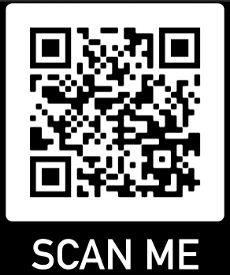
JORDAN Overall Achievements (2018-2022)
Achievements

Slide 6
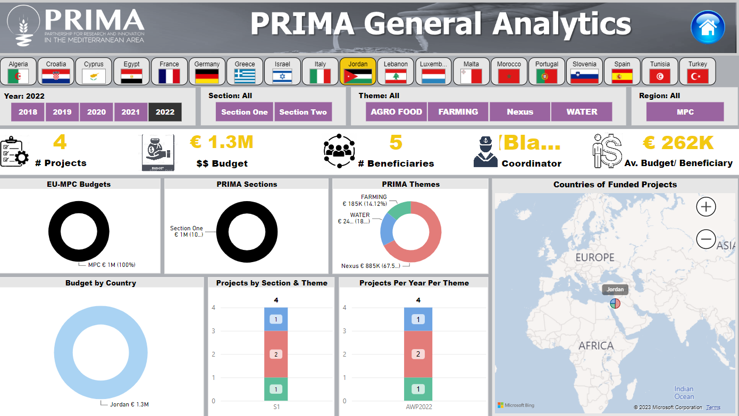
JORDAN -2022
Achievements

Slide 7
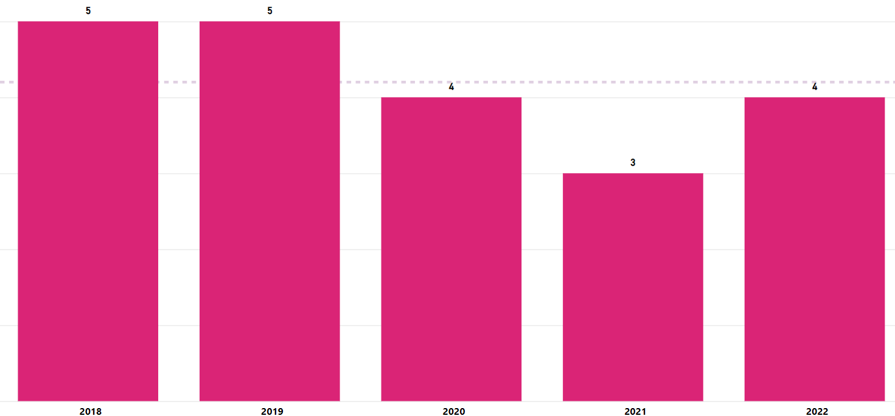
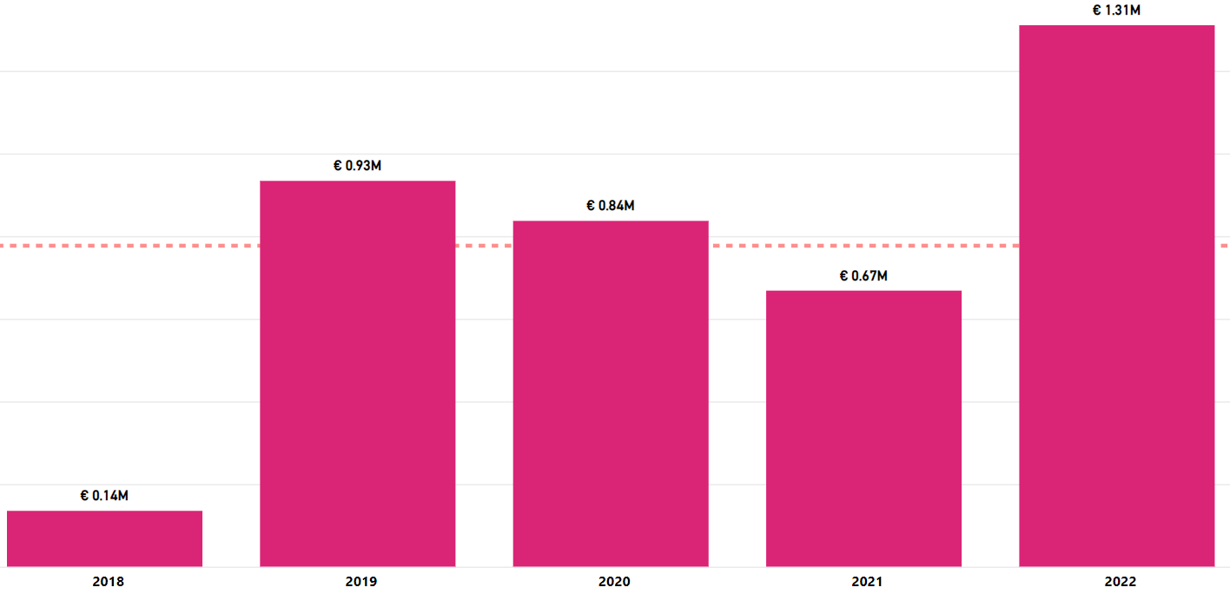
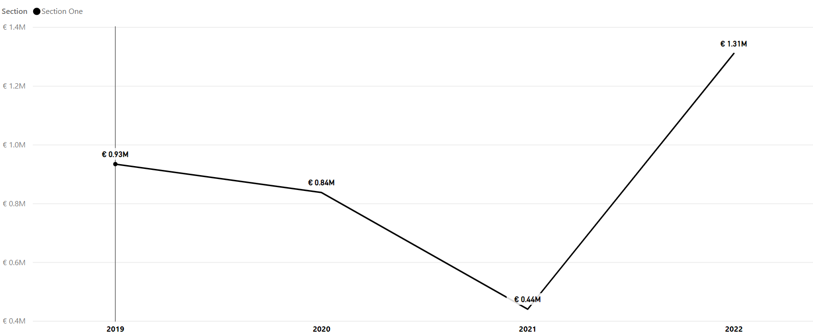
JORDAN –OVERALL PERFORMANCE
21 PROJECTS
3.9 M€
Achievements
SECTION 1-JORDAN-BUDGET

